Slide 1
Synthetic Biology
Jem Stach
BIO8041_BIO3030

Slide 2
First use of the term...
Polish geneticist Waclaw Szybalski in 1974
Up to now we are working on the descriptive phase of molecular biology. ... But the real challenge will start when we enter the synthetic biology phase of research in our field...
We will then devise new control elements and add these new modules to the existing genomes or build up wholly new genomes. This would be a field with the unlimited expansion potential and hardly any limitations to building "new better control circuits" and ..... finally other "synthetic" organisms, like a "new better mouse"

Slide 3
Synthetic biology:
a new area of biological research that combines science and engineering in order to design and build ("synthesize") novel biological functions and systems.

Slide 4
Early efforts
Salmonella protein injection system: usually used for delivery of proteins that facilitate entry of bacterium into host cell)
Reengineered to produce spider silk monomers
Spider silk is used as a high tensile strength material (bullet-proof vests)
Can produce large amounts of monomers - high value.
WHAT DIFFERENTIATES THIS FROM GENETIC ENGINEERING?
Heavy emphasis on developing foundational technologies that make the engineering of biology easier and more reliable

Slide 5
Engineering from parts
Aim is to have a number of genetic parts that can be combined as needed i.e. systems designed, engineered and tested...genes become technological components

Slide 6
Registry of standard biological parts

Slide 7
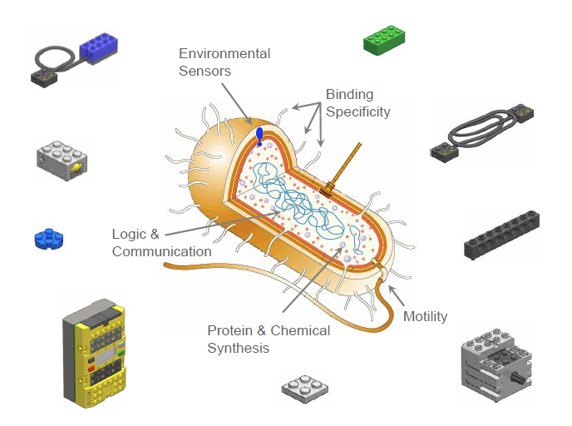
Engineering from parts
Use the standard parts in a model organism (chassis) to produce novel biological organisms

Slide 8
Re-writing...
Re-writers are synthetic biologists who are interested in redesigning from the ground up i.e. not placing components into a chassis, but building the whole organisms from individual components
This is SYNTHETIC LIFE
DNA synthesis makes it possible to produce hundreds-of-thousands of parts in days, enough to put together a whole genome...

Slide 9
Initial considerations
1: Is it even possible to put individual parts together to make a functioning genome - how would you turn it on?
2: Need to know what parts you need to put together to construct a whole genome - such that when its complete you have: an autonomous, self-replicating entity, capable of performing a thermodynamic work cycle (very good definition for LIFE) - do not need parts that are extraneous.
Where would you start if you were going to build a genome?

Slide 10
What is the minimum requirement for a bacterial genome?
Parasitic bacteria have very small genomes, but they are not independent
Mycoplasma genitalium has 517 genes (compare to the ca. 4000 of E. coli) and replicates independently

Slide 11
Researches wanted to know how many of the 517 genes are essential to survival and replication
The ultimate goal is to produce a strain that only contains the genes needed to grow and replicate - this can then be used as a vehicle/chassis for putting in custom parts to create novel species.
How would you identify these genes?

Slide 12
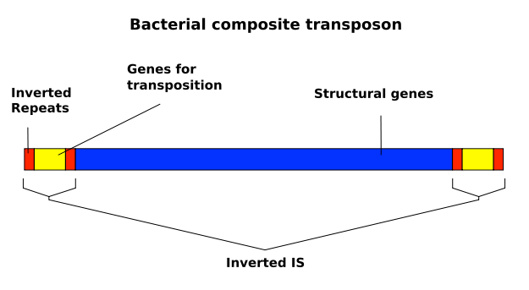
Finding the minimal genome
Authors used a transposon gene disruption technique to randomly knock down genes. They then assessed growth:
265 to 350 of the 517 genes were deemed essential under laboratory conditions

Slide 13
Can we build it?
The minimal genome appears to be small in comparison to the average genome size of bacteria.
Is it possible to reconstruct a minimal genome without resulting to cloning sections from other genomes
Chemical synthesis of DNA can achieve approx. 200 bp lengths (rapidly increasing)

Slide 14
Constructing a synthetic genome
First paper to report the complete chemical synthesis of a bacterial genome
Viral genomes had previously been constructed

Slide 15
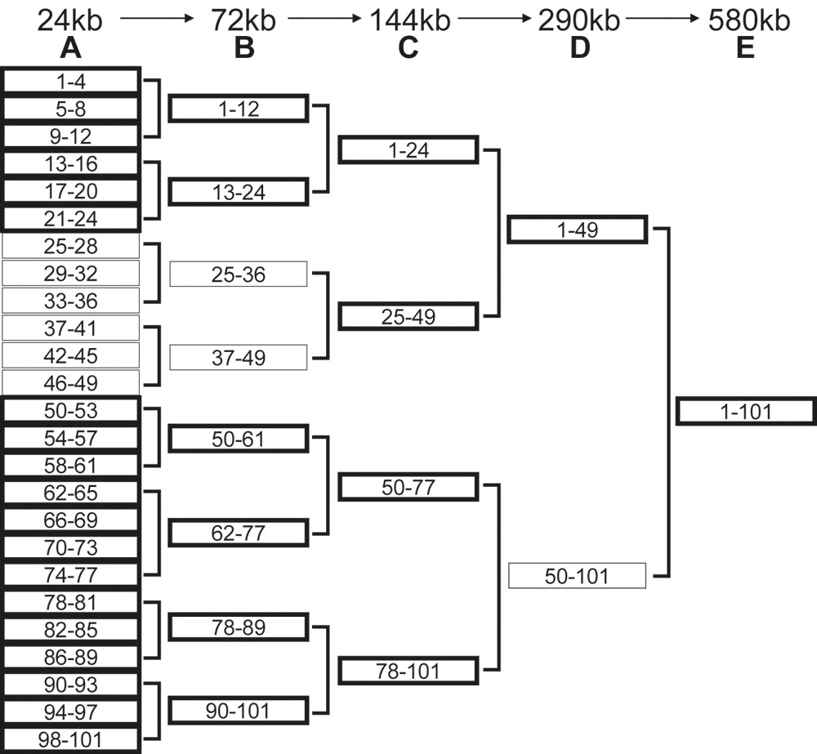
How is it done

Slide 16
Combining the parts

Slide 17
Summary 1
Minimal genome can be determined
Whole genomes can be assembled from the ground up (200 bp to 500,000 bp)
The chemically synthesized genome can have novel gene features (think the registry of parts) added to the genome to create a designer genome
But how do we get the genome to replicate, it’s just a big lump of DNA
Any ideas?

Slide 18
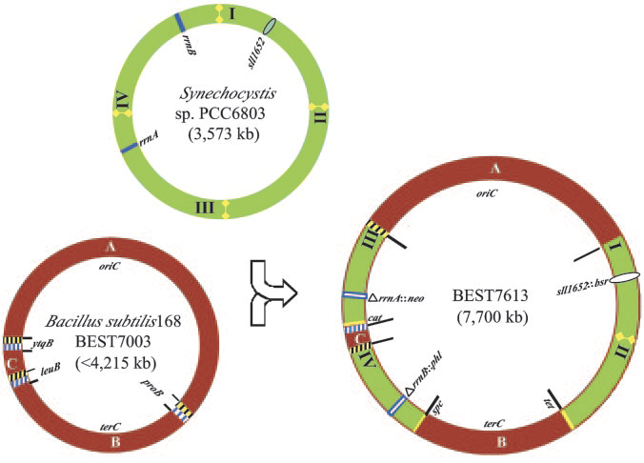
Genome transplant
Authors showed that it is possible to clone a whole genome into a host cell
In this example the genome of Synechocystis PC6803 was transplanted in the the genome of B. subtils

Slide 19
Prepare “naked” DNA
Need DNA free of proteins, RNA, and sheared DNA to serve as a donor.
Remove from the extracted genome by electrophoresis

Slide 20
Check for nudity
Protein gels prove that the purified naked DNA is free from proteins.
Ready for transplantation.

Slide 21
Whole genome cloning
Place the donor genome into host (donor genome has antibiotic resistance and betagalactosidae gene added).
Closely related species (M. capricolum strain California kid) used
Treat host to aid in DNA uptake - add genome - allow for uptake - plate and check for transformants.

Slide 22
The theory...

Slide 23
Summary 2
Nearly all components for synthetic life are in place:
Can build a genome from scratch
Can introduce novel genetic components
Can transplant the genome into a host cell for replication
remove host genome by cellular division
=

Slide 24
Synthetic life created
Last year the synthetic genome was successfully transplanted into a donor, replication and subsequent division lead to a cell that contains only the synthetic genome = synthetic life
JCVI-syn1.0

Slide 25
what parts can we build?
The standard registry of parts can be used by engineers to create functional outputs
Synthetic biologists see these DNA parts as technology
Similar to designing circuit boards from logic gates (indeed DNA parts are being used to build computers)
Examples...

Slide 26
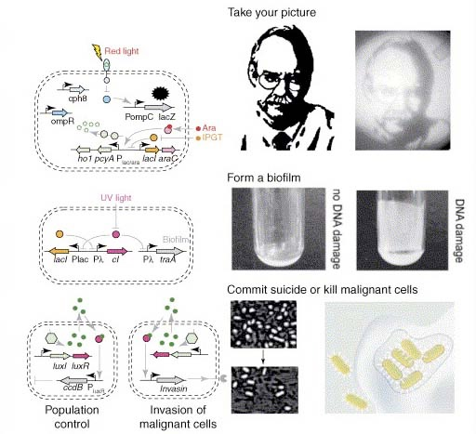

Slide 28
Future potential
Protein design (improved catalysis)
Drug production - Microbes designed to produce high quantities of drugs e.g. artemisinin (anti-malarial)
Pollutant clean-up - synthetic organisms programmed to scan the environment for toxins and break them down before they cause harm
Medical - synthetic organisms injected to seek and destroy pathogens and tumors
Fuel production - cells designed to take raw waste and produce hydrogen and ethanol

Slide 29
Malaria
Mosquito-borne infection caused by protist Plasmodium
Kills ca. 3 million people per year.
Recently Artemisinin has been used to treat Malaria.
Effective therapy in combination treatment

Slide 30
Malaria
Artemisinin is extracted from plant Artemisia annua.
Only produced under certain conditions of stress.
Produced in small quantities.
Purification is difficult.
Low yields, impurities present, consumption of large amounts of natural resources.

Slide 31
Synthetic biology solution
Production of amorphadiene (precursor of artemisinin) in bacteria.
Enables increase in yield, easy purification, low cost production, low natural resource consumption.
Also, slight modification to produce backbones to other terpenoid-based drugs

Slide 32
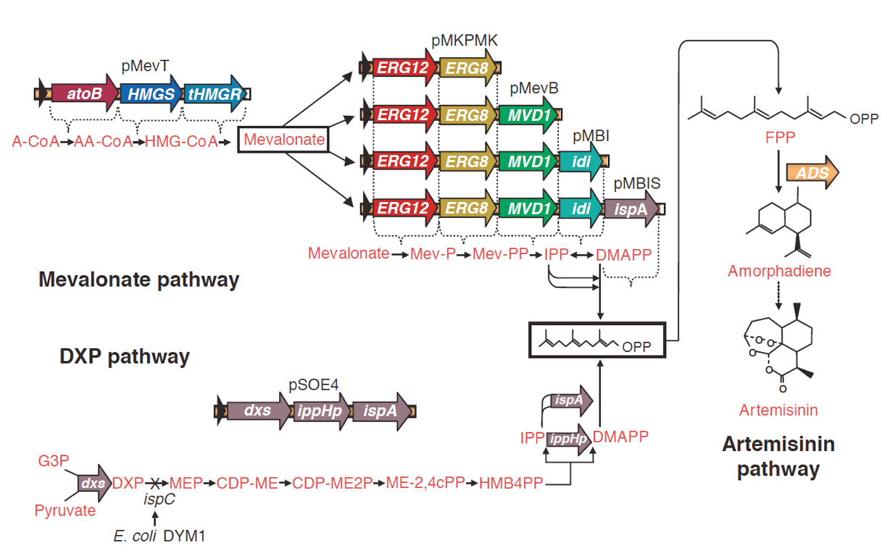

Slide 33
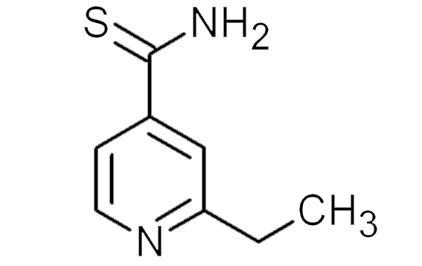
M. tuberculosis
Human kidney cell line
ethA
P
P
ethR
PSV40
EthR-VP16
EthA
VP16
InhA
EthR
Non-cytotoxic
cell-permeable
EthR-inhibitor
Pmin
OethR
SEAP
Synthetic biology to make constructs for screening

Slide 34
Transcription
VP16
assay colour
RNA pol
EthR
SEAP
SEAP
Operator seq
ethA
Promoter
VP16
No transcription
EthR
RNA pol
inhibitor
SEAP
Operator seq
ethA
Promoter

Slide 35
Risks?
Synthetic biology differs from chemistry - synthetic organisms are self-replicating and can evolve
Organism escape from labs
Uncontrolled proliferation
Malicious use - viral genomes have been reconstructed from components - bioterrorism

Slide 36
Ethics
Synthetic life is a science that creates debate:
Should we create life?
Can you place patents on life
Such a new science needs legislation - currently meetings, and guidelines being driven by the scientists themselves.
Read the current issues in the ethics of synthetic biology: SYNBIOSAFE

