Slide 1
Application of antisense RNA in natural product discovery
Jem Stach
BIO8041-BIO3030

Slide 2
Natural antisense
Bacteria regulate a diverse range of processes using small non coding RNAs
These include: riboswitches, protein-binding RNAs, CRISPR RNAs, and cis- and trans- encoded mRNA-binding RNAs (antisense RNAs)
You should be familiar with their biology - particular natural antisense RNAs
See BlackBoard for a review (Regulatory RNAs in Bacteria)

Slide 3
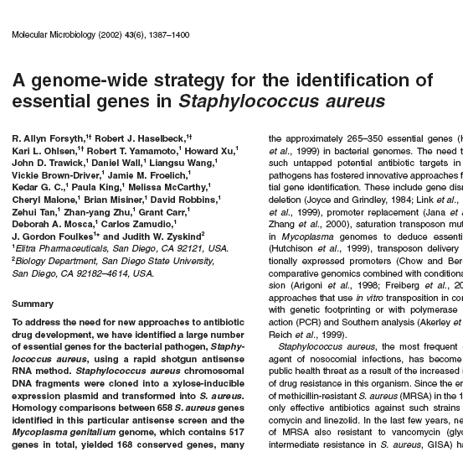
First applications of antisense in bacteria
The first practical application of antisense techniques in bacteria was the identification of essential genes
As discussed in the previous lectures, identification of novel essential genes is a precursor for drug development
Authors identified 658 essential genes in the genome of S. aureus

Slide 4
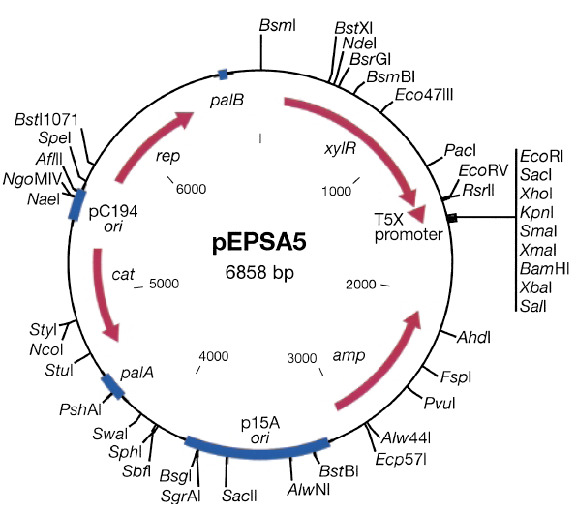
How was it done?
The authors took a genome-wide approach to identifying essential genes
The genomic DNA of S. aureus was extracted and sheared into fragments of 200 - 800 bp.
The fragments are cloned into an inducible expression vector in random orientation.
The resulting transformant colonies are screened on inducing and non-inducing media (very similar to lecture on bacteriophage genomics)
HOW DOES THIS IDENTIFY ESSENTIAL GENES..?

Slide 5
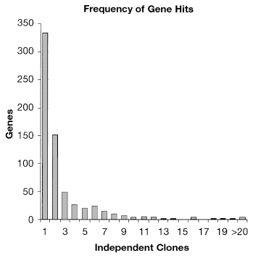
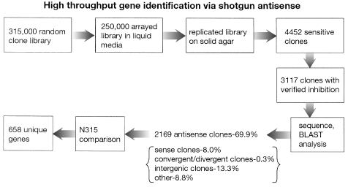
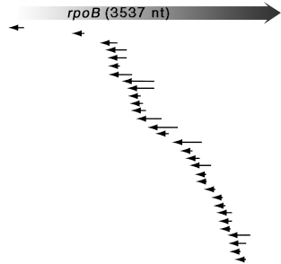
Essential gene identification
Screening of 315,000 clones ensures a 99.9% probability of covering the entire genome.
If an expressed fragment acts as an antisense RNA and silences the expression of an essential gene, the clone will not grow when induced.
Frequency with which single genes were targeted by shotgun antisense. rpoB gene is shown demonstrating the location and size of antisense fragments

Slide 6
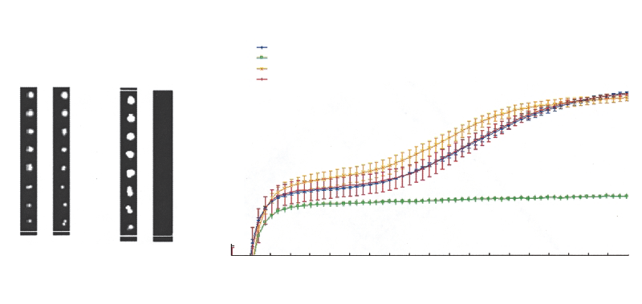
When S1-760A is induced with xylose, there is clear growth inhibition on both liquid and solid media. Method is effective for producing antisense RNAs and identifying essential genes
Testing antisense expression of the growth of S. aureus
pEPSA5 is the empty vector, S1-760A is the vector carrying an antisense fragment to rplQ (ribosomal protein)
pEPSA5
S1-760A
S1-760A
S1-760A -induced
pEPSA5
pEPSA5 -induced
- +
- +
OD600
Time in hours

Slide 7
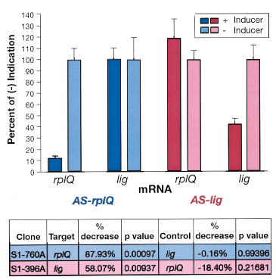
Specificity
Targeted mRNA abundance is only decreased with the expression of their specific antisense
mRNA abundance assayed by RT-PCR
rplQ mRNA decreases when the AS-rplQ is expressed, whereas lig mRNA is unaffected
The reverse is also true:
antisense growth inhibition is target specific

Slide 8
How does antisense expression help identify novel antibiotics?
If antisense RNA is being expressed then less of the target mRNA is produced = less target protein in the cell. Bacterium can still grow.
However, if an inhibitor of the target protein is present in the antisense expressing strain, the cell is more sensitive to the inhibitor -Enzyme is being inhibited and there is not enough present in the cell, plus the cell can’t make more protein.
SUGGESTIONS...

Slide 9
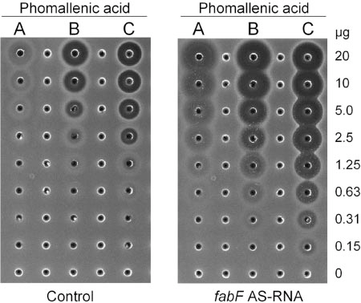
Natural products contain mixtures of compounds, some at very low concentrations. While active there may not be enough in the extract to kill the test organism.
However, antisense expressing cells are extremely sensitised to inhibition.
Thus, very low concentrations of inhibitors can be identified - Excellent for natural products screening.

Slide 10
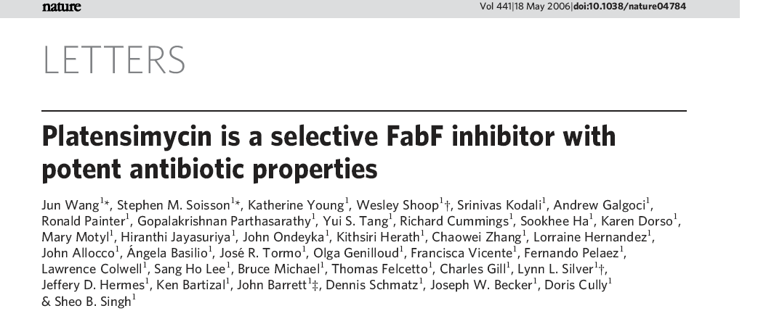
Antibiotic discovery using antisense screening: the Platensimycin story

Slide 11
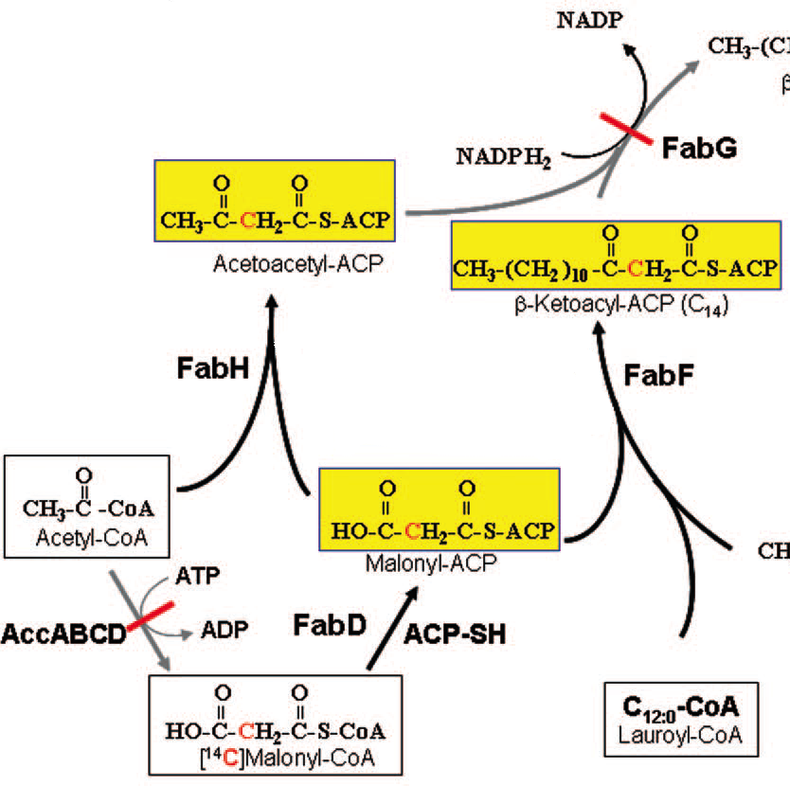
Merck Pharmaceuticals antibiotic screening program. Interested in inhibitors of fatty acid biosynthesis. FabH and FabF expressed as an operon - Thus and asfabF strain can be used to screen for inhibitors.
Screen 250,000 natural product extracts (bacterial) in antisense screen
N.B. These extracts had been used for antimicrobial screening for decades - No FabF/H inhibitors ever identified

Slide 12
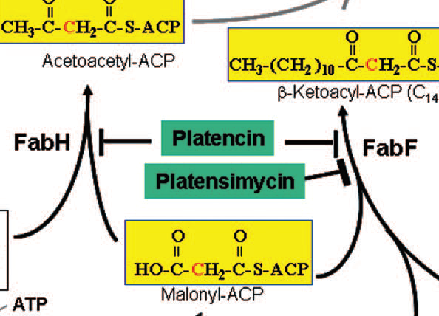
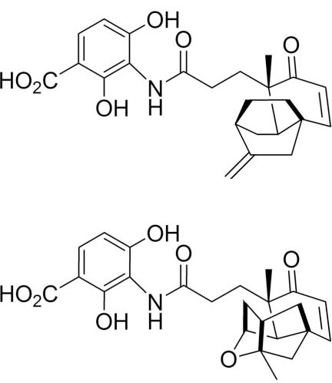
Two novel inhibitors identified: Platensimycin and Platencin
Novel antibiotic structures, novel mode of action.
Compounds only identified through antisense screening. Antisense screens can revitalize natural product extract libraries!

Slide 13
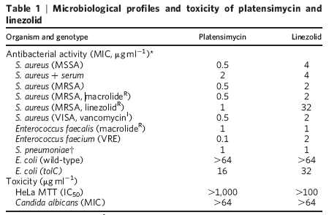
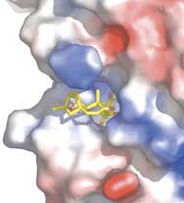
Platensimycin a very potent antimicrobial

Slide 14
So far we have only described Gram- positive bacterial antisense screens.
Expressed antisense was not developed as quickly as in Gram-negative bacteria.
Mixed reports of efficiency in E. coli
Technical improvements were needed.
Gram-negative pathogens are emerging as as serious health threat - in some species, the presence of the cell membrane and multiple efflux pumps makes them extremely resistant to antimicrobials

Slide 15
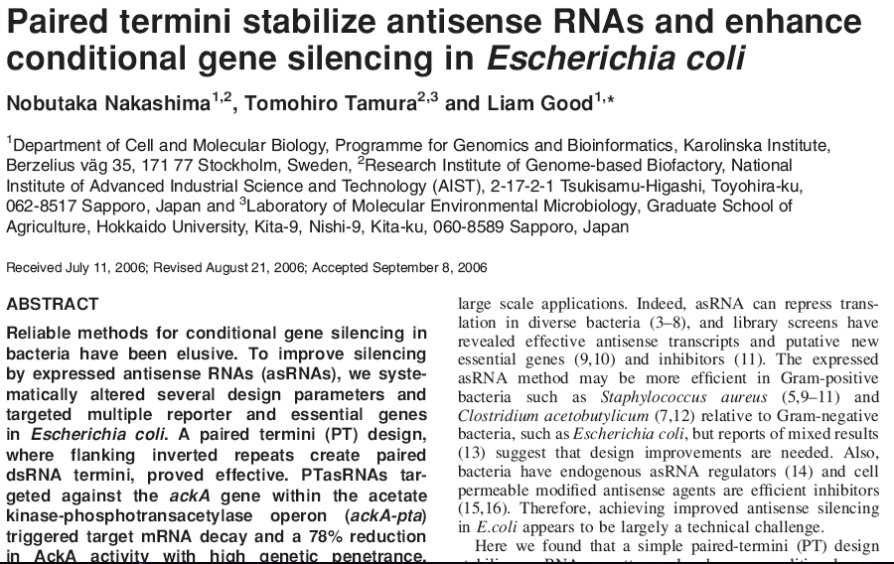
Study by Nakashima et al., 2006 aimed at improving antisense in E. coli
Authors employed a paired termini approach to improving stability of the antisense transcript.

Slide 16
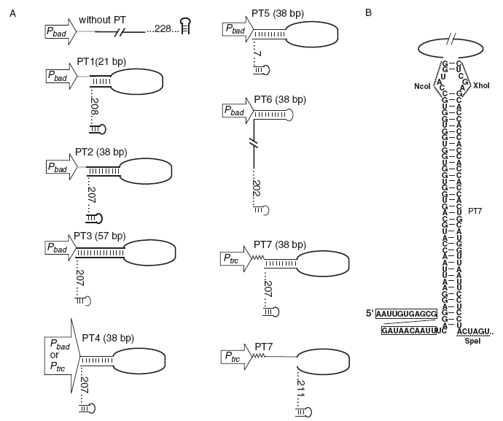

Slide 17
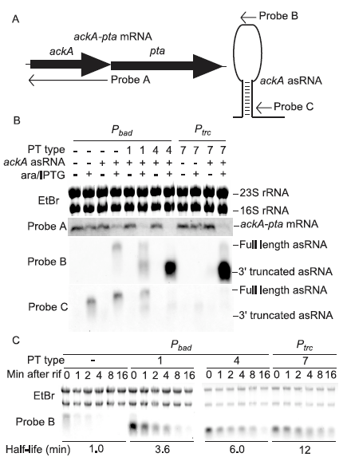
PT-asRNAs are more stable
The presence of the PT on the RNA stabilizes the asRNA
Abundance in cell increases, increasing gene silencing
Probable the the asRNA/mRNA duplex is cleaved by an RNAse
PT structure may also help to free the asRNA binding site, by preventing secondary structure formation.

Slide 18
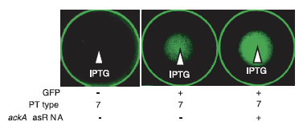
Examples using PT-asRNA
ackA was targeted for antisense silencing
AckA is responsible for carbon flux to and from acetate
In industrial fermentation overflow metabolism can reduce growth and protein yield.
Upon induced silencing a higher yield of heterologous protein should be produced.

Slide 19
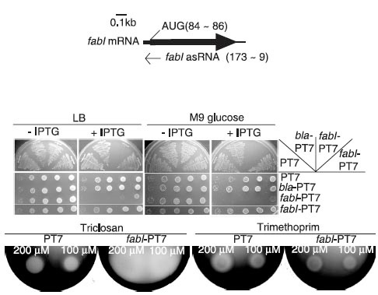
Examples using PT-asRNA
fabI is involved in fatty acid synthesis
FabI is specifically inhibited by Triclosan
asfabI expressing E.coli should be sensitized to Triclosan
∆

Slide 20
Other methods for controlling transcript abundance
Suggestions?

Slide 21
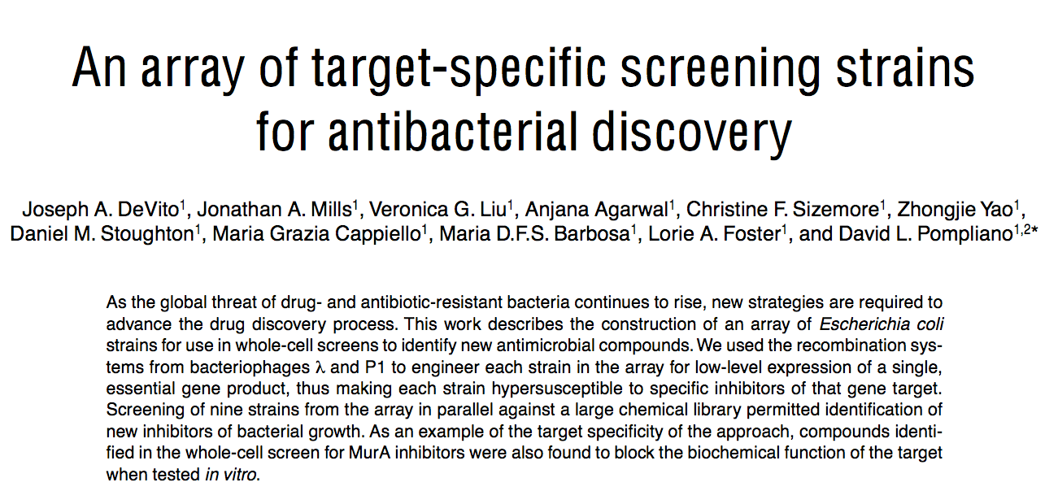
Control of the promoter

Slide 22
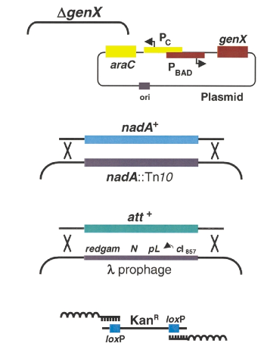
Modify strains
Add a plasmid copy of the essential gene under the control of a promoter of choice.
Delete the wild-type essential gene on the chromosome.
Level of inducer influences promoter activity and thence transcriptional abundance of essential gene mRNA.

Slide 23
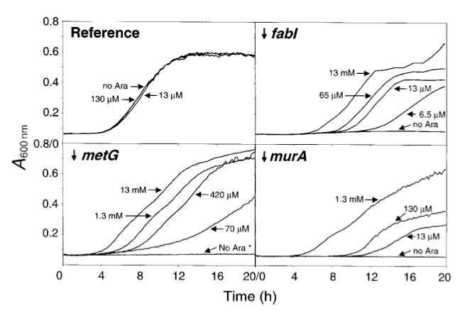
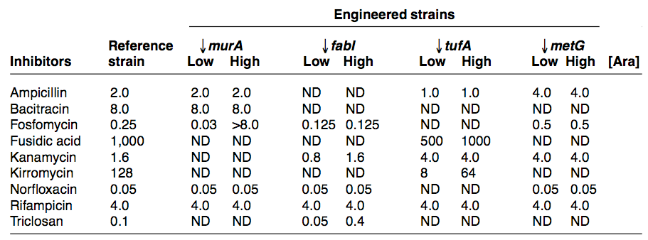

Slide 24
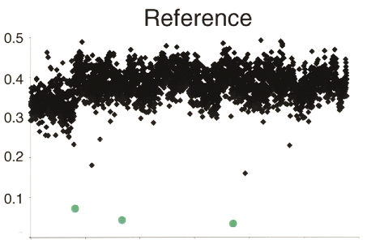
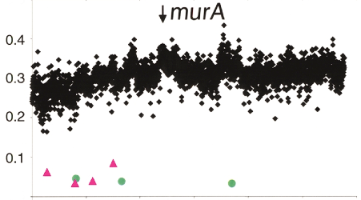
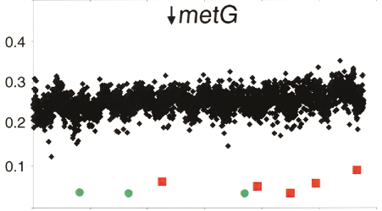
Screen using strains

Slide 25
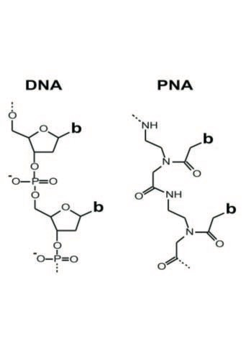
Synthetic nucleic acids
DNA mimics such as peptide nucleic acid (PNA) locked nucleic acid (LNA) or phosporodiamidate morpholino oligonucleotide (PMO) can be synthesised.
DNA-PNA hybrids have very high thermal stability due to neutral backbone of PNA = very stable binding to DNA or RNA.
Highly specific binding - very sensitive to mismathces
Not degraded by cellular enzymes
Can be applied in antisense applications

Slide 26
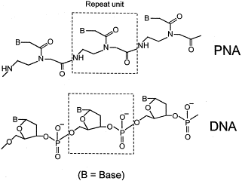
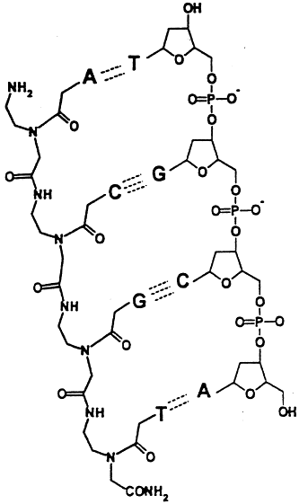

Slide 27
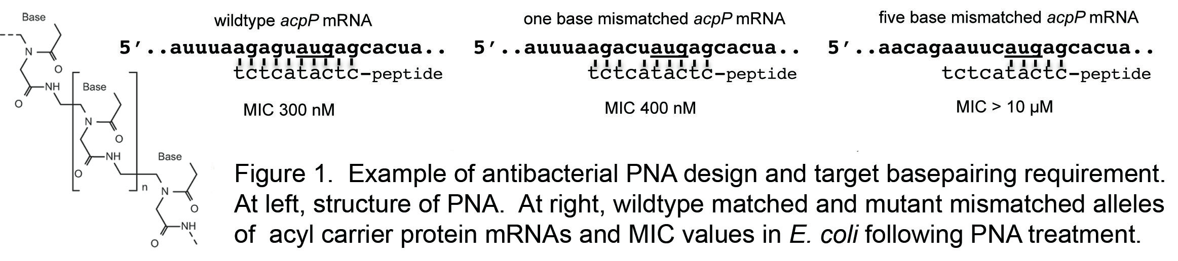
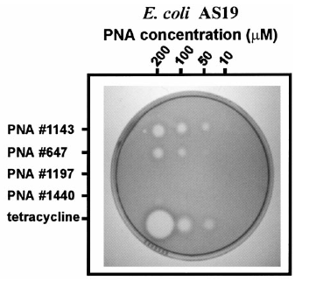
DNA mimics & antisense

Slide 28
DNA mimics benefits
Do not need genetics - not plasmid-based expression - molecule is synthesised an delivered as a normal antimicrobial compound.
Can use as little as 9 base pairs for your target.
Stability of PNA - not recognised and degraded as with expressed RNA

Slide 29
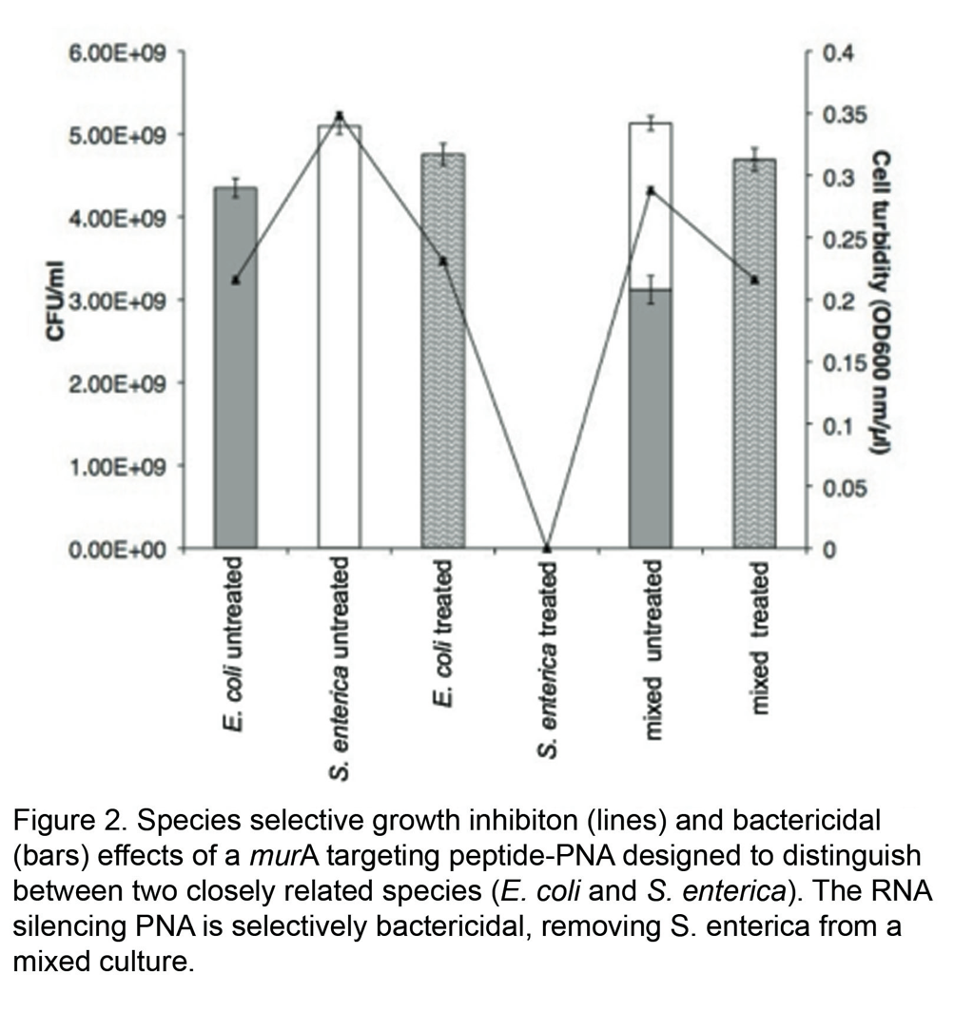
Application
We have made use of the properties of PNAs to design species-specific antibacterial compounds
Can target specific species for bactericide - select between highly related strains - not possible using simple antibiotic therapy
Prevent killing of beneficial microbes and lower incidence of resistance

Slide 30
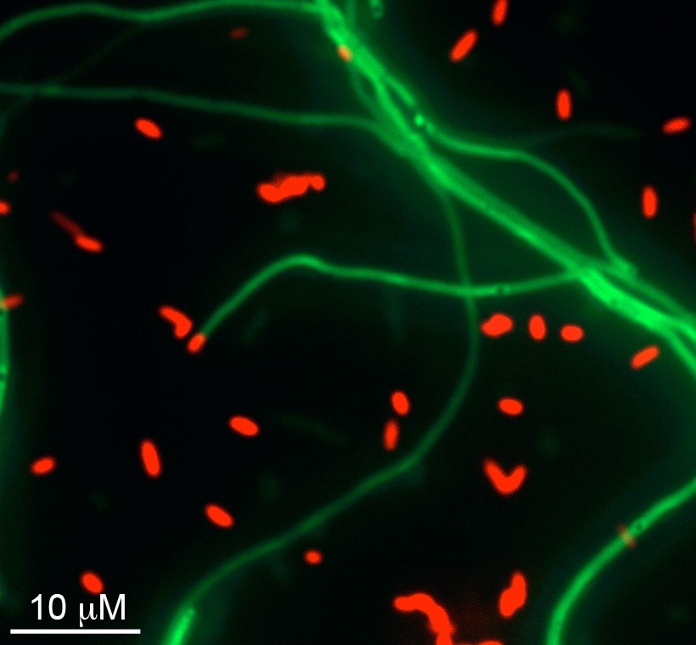
Application
We have made use of the properties of PNAs to design species-specific antibacterial compounds
Can target specific species for bactericide - select between highly related strains - not possible using simple antibiotic therapy
Prevent killing of beneficial microbes and lower incidence of resistance
PNA designed to be specific for ftsZ of Salmonella typhimurium LT2 (GFP labelled). The PNA has 2 mismatches with E. coli (dsRED labelled)

Slide 31

Antisense in Streptomyces
Streptomyces use antisense regulation.
We wanted to determine if we could use artificial antisense RNA tools to manipulate antibiotic production in Streptomyces

Slide 32
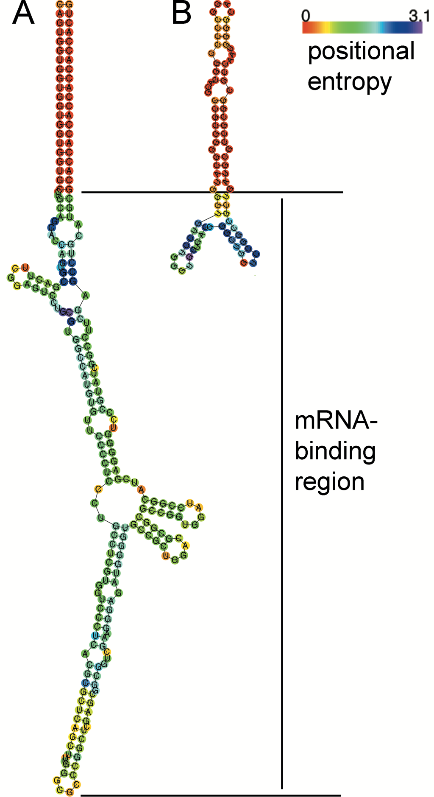
We designed a PT-asRNA to silence the production of actinorhodin
Predict structure of asRNA -similar to that of a natural asRNA in Streptomyces (see later)
Perhaps Streptomyces were using PTs a long time before us.

Slide 33
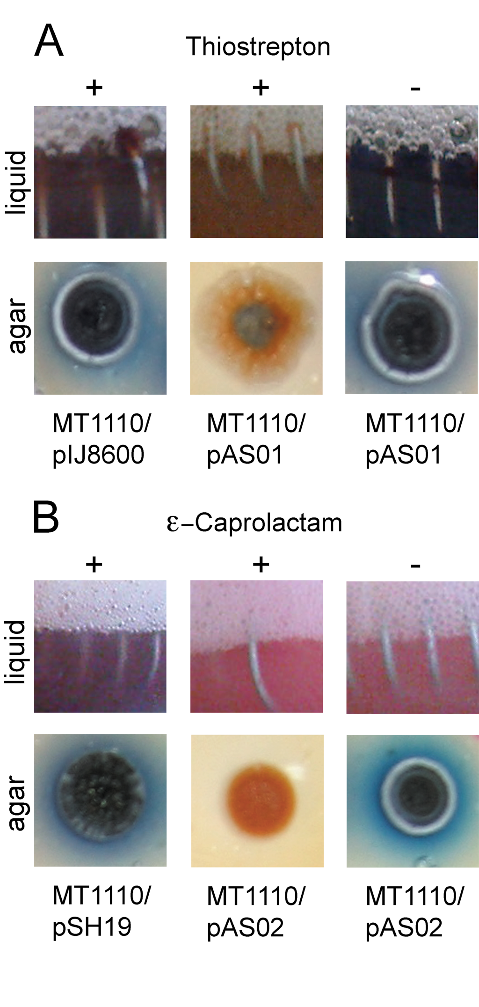
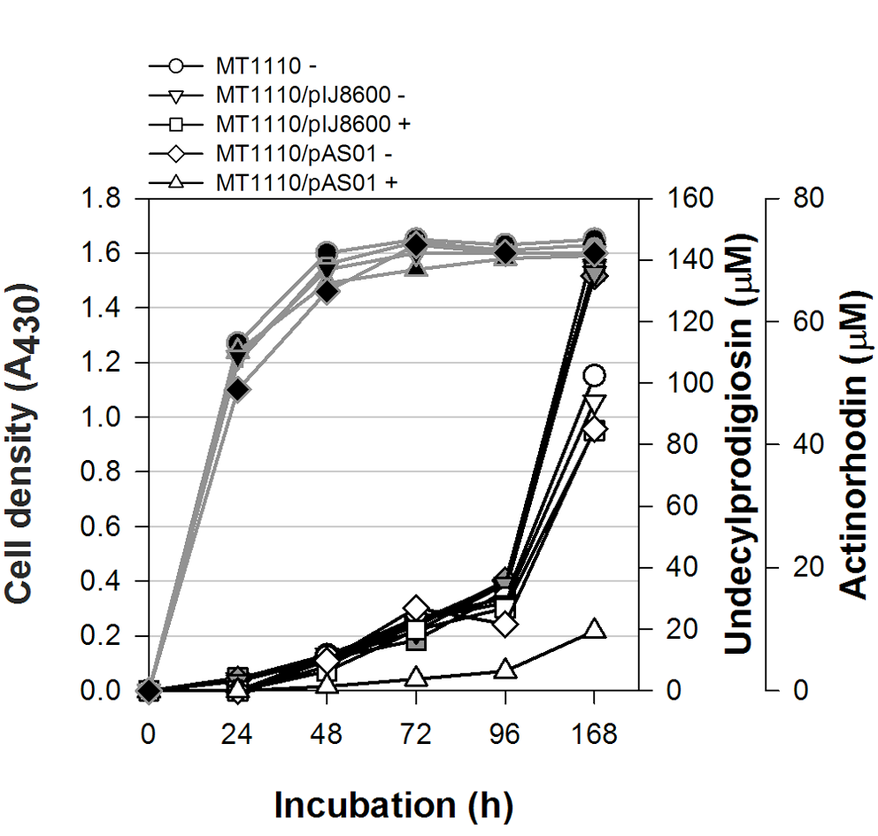

Slide 34
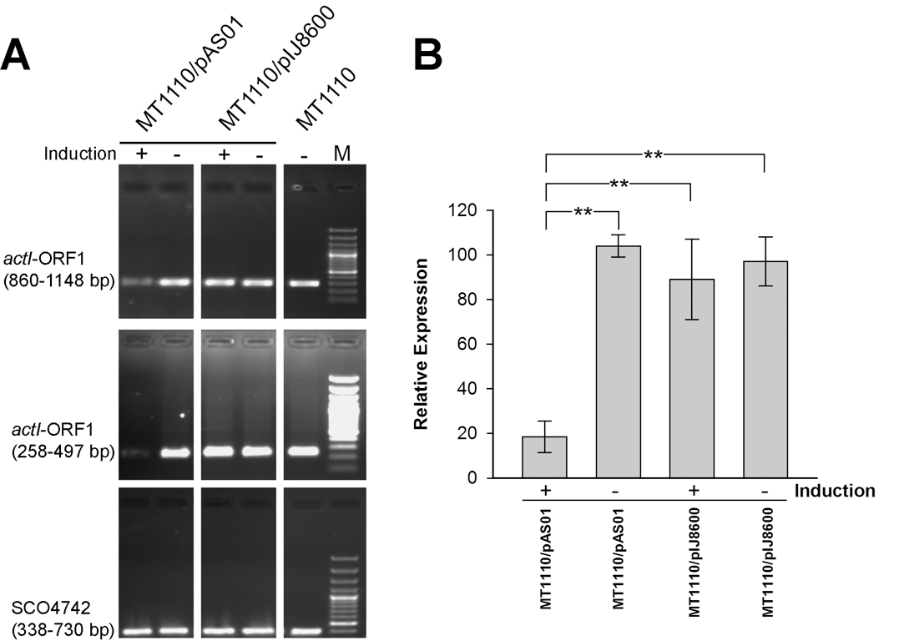

Slide 35
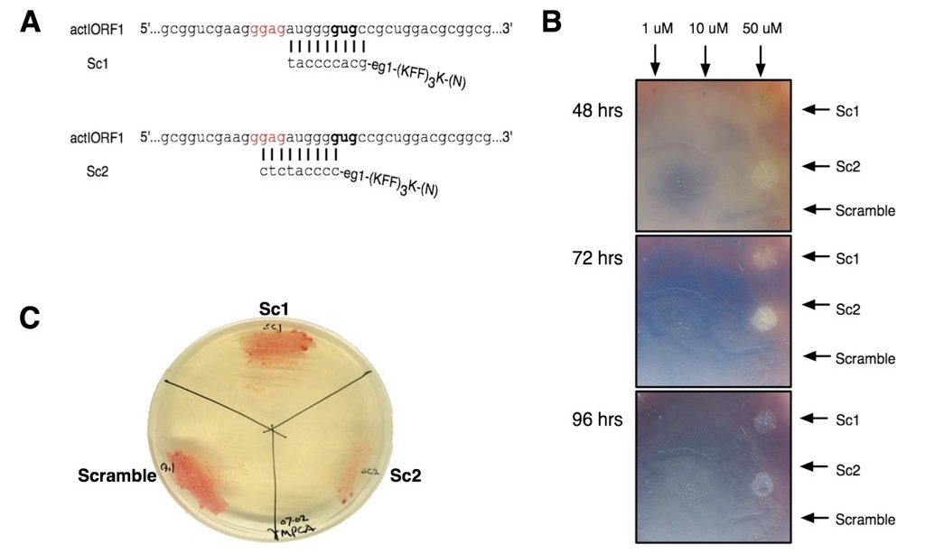
Use of synthetic DNA mimics in antisense inhibition

Slide 36
What use is it to turn off an antibiotic?
Some strains have production of high abundance antimicrobials deleted so that lower abundance compounds can be detected
Proof-of-principal: if we can control gene expression, we may be able to control the repression of antibiotic gene clusters.
Evidence from natural systems - the natural asRNA from Streptomyces (earlier) prevents the translation of a repressor of antibiotic production - when this asRNA is expressed antibiotic production is turned on.

Slide 37
Summary
Antisense methodology can be employed to identify novel essential genes = novel targets
Controlled expression of asRNA can be used to produce strains sensitised to specific inhibitors - inhibitor plus target identified in one screen
Antisense screening is particularly valuable in natural product screens - low concentrations of active compounds present in extracts
Synthetic DNA mimics can be used to overcome need to perform genetics in target

