Slide 1
BIO3030 BIO8041
Genomic approaches to natural product discovery
Antimicrobial discovery
Jem Stach

Slide 2
Aims
Introduce the concept of silent and cryptic biosynthetic gene clusters
Briefly cover the biosynthesis of natural products
Demonstrate genome scanning and heterologous expression methods as means to access silent and cryptic gene clusters
Introduce epigentic and cell-free approaches.

Slide 3
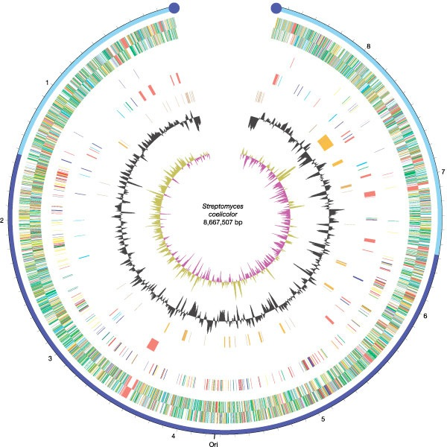
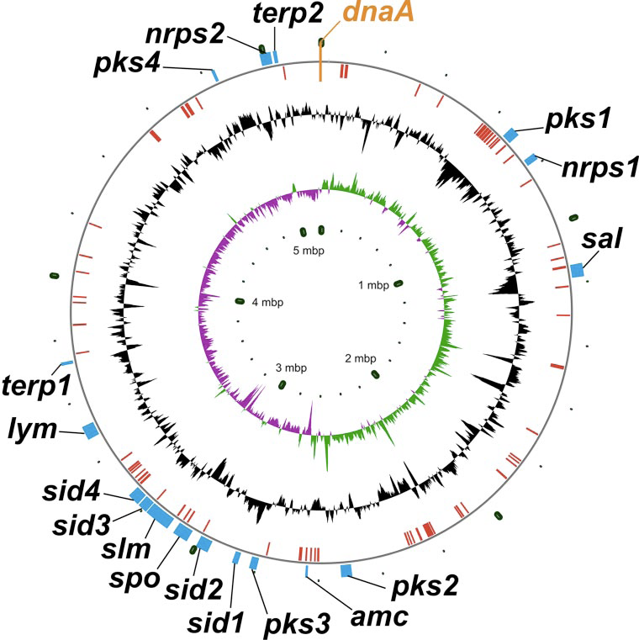
Genome sequencing the producers: hidden biosynthetic clusters revealed

Slide 4
Majority of biosynthetic gene clusters encode for products that have never been isolated
So, the question is: “How do we access this vast resource?”
Remember, it is worth doing: nearly all the marketed antibiotics come from these organisms...
worth billions!
These gene clusters are referred to as “silent” or “cryptic” biosynthetic gene clusters

Slide 5

Known compounds
Unknown compounds
Organisms already in culture - 1000’s of more compounds

Slide 6
Biosynthetic gene clusters
The majority of natural products (antimicrobial, anticancer) from bacteria and fungi are biosynthesized by polyketide synthases (PKS) and non-ribosomal peptide synthetases (NRPS)
PKSs can be divided into three classes (I, II, III) depending on how the enzymes are organized (not required for this lecture)
Type I PKSs and NRPS tend to be large multifunctional proteins

Slide 7
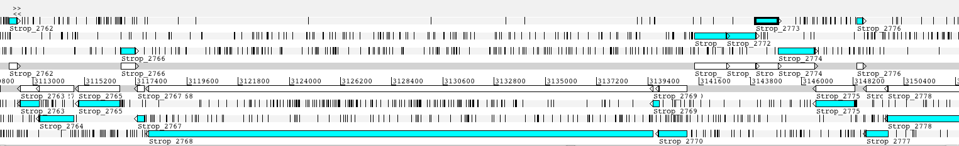
Genome gazing
Thus, genome sequence information can be readily scanned to identify regions that are likely to encode proteins that biosynthesize natural products. This was how the hidden biosynthetic capabilities of Streptomyces species was revealed.

Slide 8
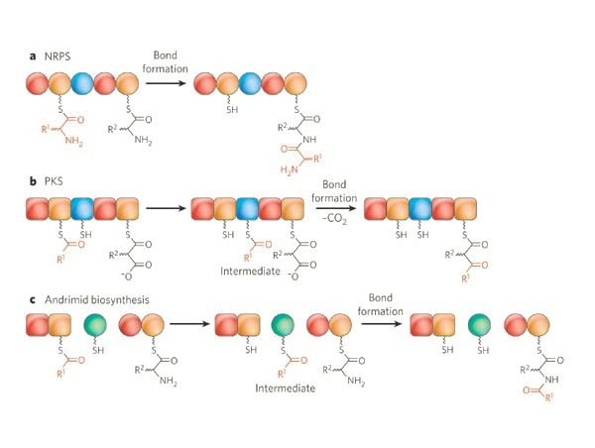
Molecular logic: Red - substrate recruitment. Orange - substrate carriage. Blue - Bond formation. Green - NRPS/PKS bond formation
There is a molecular logic to how NRPS and PKS proteins synthesize their products.
PKSs use acyl units to initiate and grow a polyketide chain.
NRPSs use amino acid units (make a polypeptide without a ribosome)

Slide 9
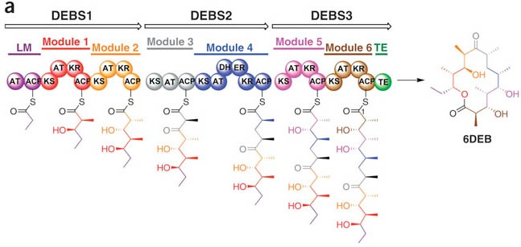
Erythromycin biosynthesis a model example of PKS assembly, three proteins each contain modules (covalently linked enzyme subunits). Each module is responsible for loading and extending the chain. The loading module selects a propionyl-starter unit, other modules all load a methylmalonyl extender unit.
AT
acyltransferase
KR
β-ketoacyl reductase
ACP
acyl carrier protein
DH
dehydratase
KS
β-ketoacyl synthase
ER
enoyl reductase

Slide 10
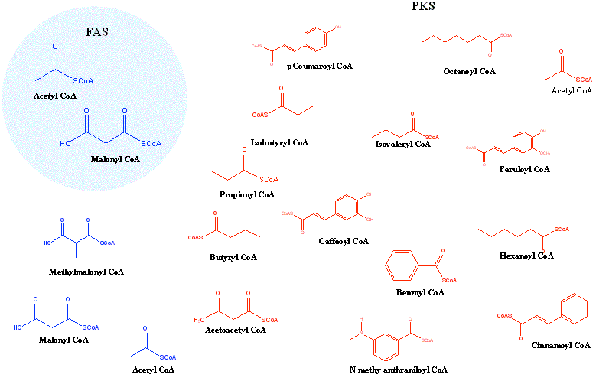
Structural diversity
PKS can load and extend using a diversity of acyl subunits - combined with different levels of keto reduction, the structural diversity space of polyketides is vast. Similar for NRPS that can use both proteogenic and non-proteogenic amino acids.

Slide 11
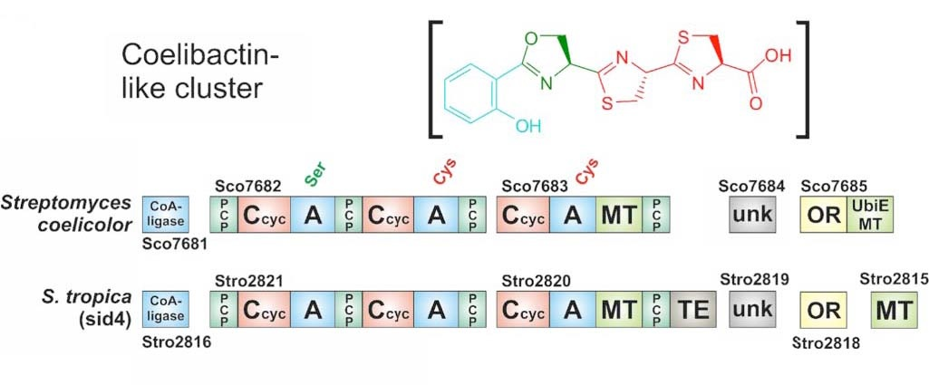
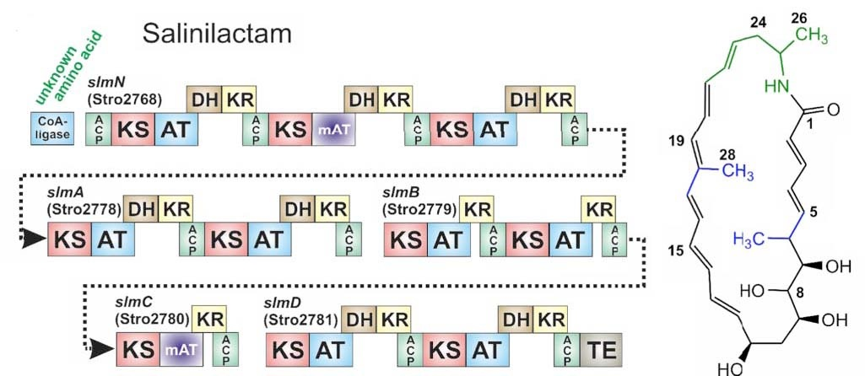
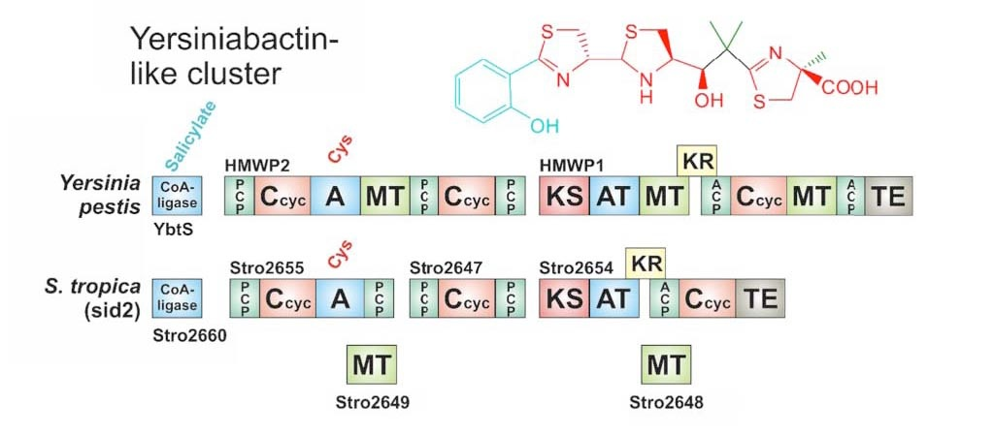
Clusters

Slide 12
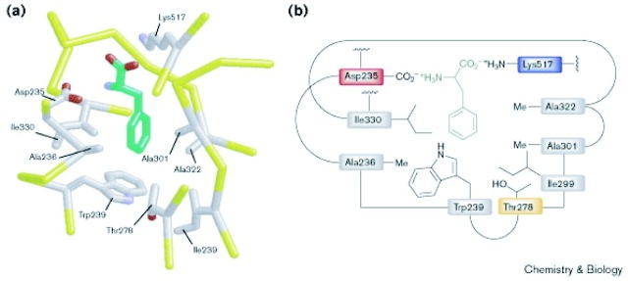
Prediction of structure
It is possible to predict which acyl or amino acid units will be selected to be incorporated into the natural product. The molecular logic defines the order in which these units will be joined together - it is possible to predict the approximate structure of the compound that will be synthesized by a PKS or NRPS

Slide 13
Summary part 1
Genomes of natural product producing bacteria have the ability to produce more compounds than are seen in standard fermentation.
Natural product compounds are mainly synthesized by PKS and NRPS enzymes
These enzymes are often large multi-functional enzymes
It is possible to predict the structure of a compound from the sequence of its NRPS or PKS gene cluster.

Slide 14
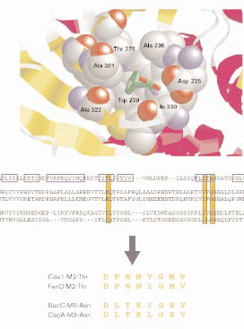
Genome mining part 1
1. Predict the structure of compound that will be produced from a cryptic gene cluster
2. Predict chemical and physical properties from structure
3. Use the information to induce production of compound and/or identify the conditions in which it is produced.

Slide 15
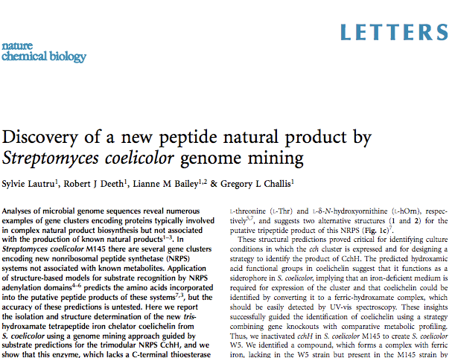
Genome mining part 2
One of the first applications of genome mining was the discovery of coelichelin from S. coelicolor.
This strain is the model Streptomyces sp.
First to be sequenced

Slide 16
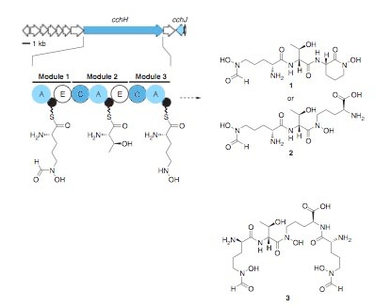
Prediction of structure leads to isolation
The authors made a structural prediction from the cryptic biosynthetic cluster.
The predicted structure had similarity to known compounds that bind molecular iron (siderophores)
Authors grew the strain under iron-limiting conditions to cause expression of the compound
The product was converted into a ferric hydroxymate complex that is detectable by UV-vis spectroscopy.
The hydroxymate complex was purified, the ferric iron removed and the final structure determined by NMR
Structure was not as predicted - new type of biosynthesis identified

Slide 17
Discovery from organisms without genome sequences
Suggestions on how we use genomic approaches when our library contains hundreds to thousands of strains...
Producing a full genome sequence can be very expensive - Not exactly high-throughput.

Slide 18
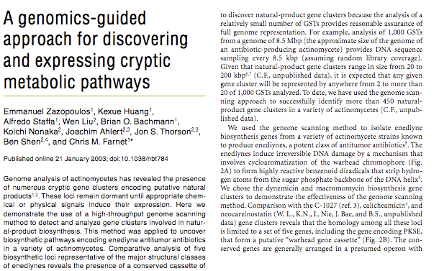
Genome scanning
Authors describe a novel method for identifying cryptic biosynthetic gene clusters and identifying the conditions under which they are produced

Slide 19
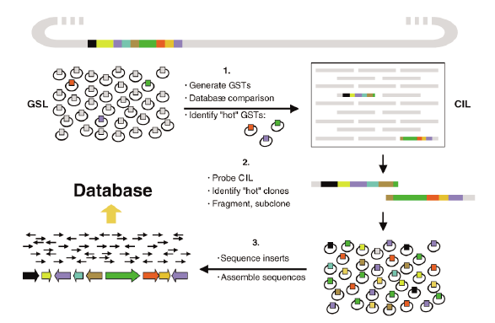
How it works - in theory

Slide 20

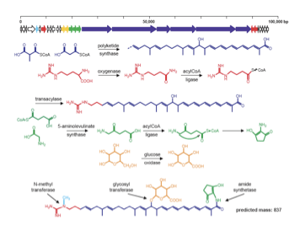

How it works - in practice

Slide 21
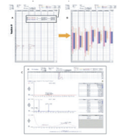
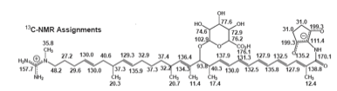
How it works - in practice

Slide 22
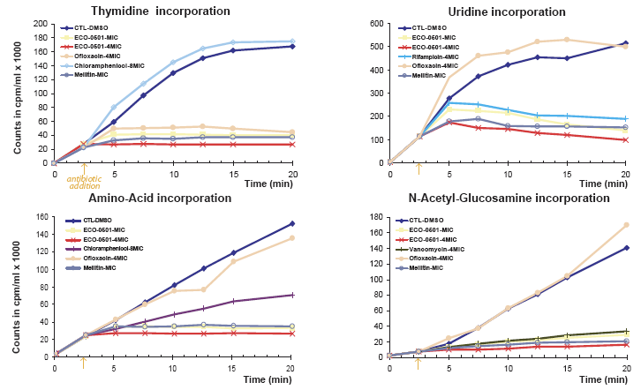
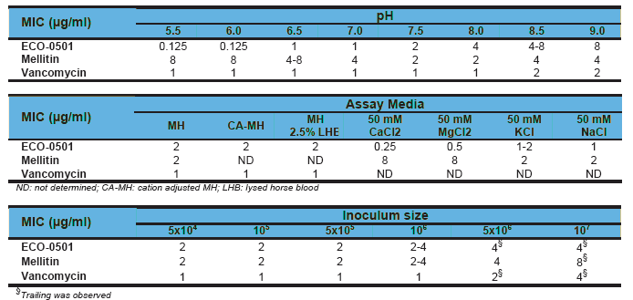
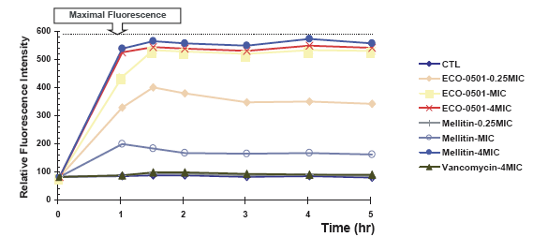
Is it a good antibiotic?
Once a novel compound is predicted, isolated, purified and scaled-up, its function needs to be tested.
In this case, the compound was antibacterial.
precursor incorporation assays showed a global response to exposure.
Cell wall permeability assayed proved that it disrupts cell wall structure

Slide 23
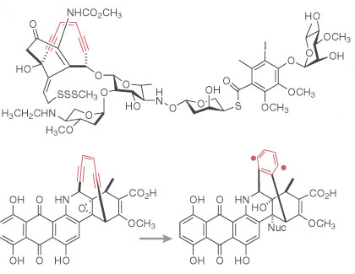
Non-antimicrobials...
Natural products are not only used as antimicrobials
Very good history of use in as anti-cancer compounds
Enediynes discovered in actinomycetes
Among the most cytotoxic compounds ever discovered - 50%-effective dose ranges in cell killing assays of 10⁻¹⁷ M, nominal concentration of one molecule per cell!
Mode of action - bind to DNA, ring is under strain, binding results in a ring collapse and diradical formation.
The diradical abstracts hydrogen ions from the DNA resulting is strand scission
Too toxic for direct application - attached to antibodies for targeted delivery to tumor cells -MylotargTM

Slide 24
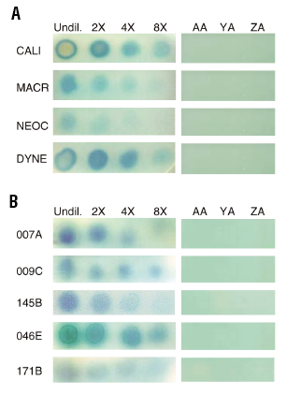
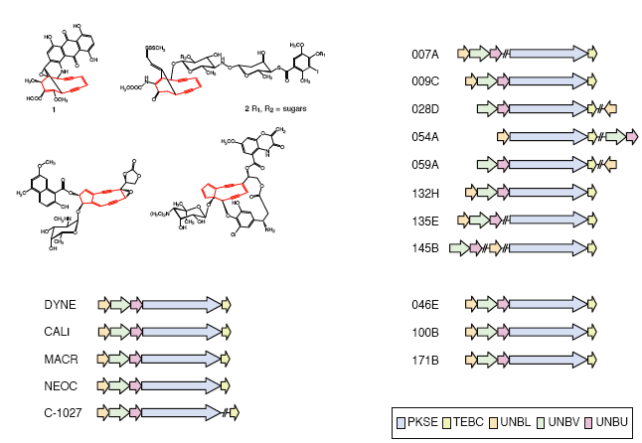
Identifying novel enediynes
Authors took 70 strains and subjected them to genome scanning.
10% of the strains had genes for enediyne biosynthesis
Strains prioritized on genetic basis i.e. those genes that look diverse/novel
Allowed authors to concentrate on novelty
Strains put through a number of fermentation conditions and screened in assay that identifies DNA damage

Slide 25
We can identify novel biosynthetic genes in genomes and try different fermentation conditions to produce the new product - having predicted structures aids in identifying which fermentation condition is producing the desired compound
How else can we use the genetic information to access these compounds?

Slide 26
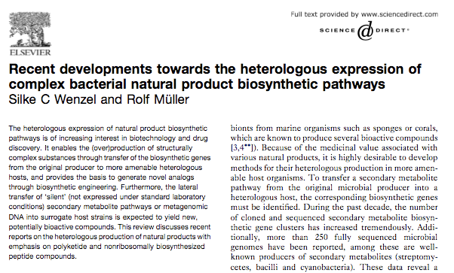
Move the genes into a new host
Biosynthetic gene clusters are tightly controlled - regulatory network to ensure that the natural products are only expressed under the right environmental signals
However, if we can remove the information that encodes the product from the regulatory network, the product may be produced.
Clone the cluster into a heterologous host

Slide 27
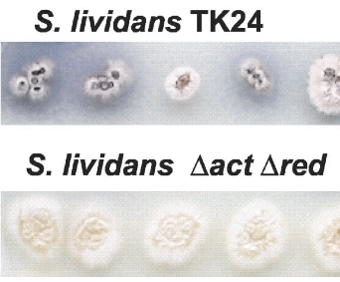
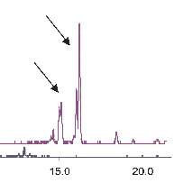
Super hosts
Construct Streptomyces hosts that have had their own biosynthetic gene clusters removed.
Engineer in properties that aid in the production of natural products (precursor biosynthesis).
Overproduce compounds, easy to identify the heterologously expressed compound

Slide 28
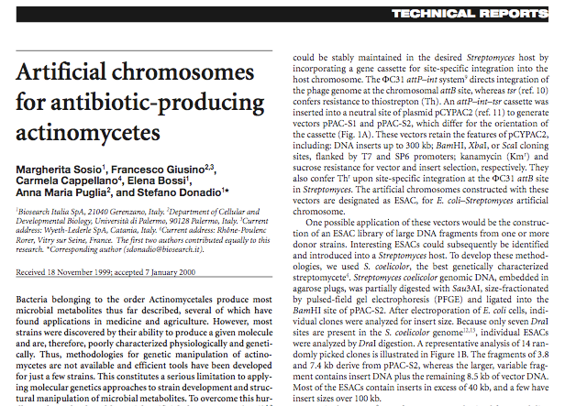
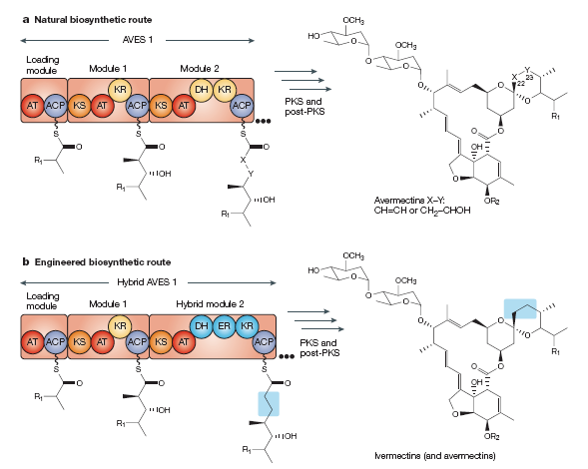
Move entire clusters
Until recently we were limited to heterologously expressing smaller biosynthetic clusters (30-40 Kb) on cosmids and fosmids
Majority of biosynthetic genetic are > 100 Kb
Need vectors that can carry fragments of this size
Artificial chromosomes are now being used for this purpose
Also enables re-engineering of the biosynthetic pathway

Slide 29
Summary part 2
Focused on two main methods for identifying new compounds: molecular-based and cultivation-based (or union of the two).
Molecular-based: identifying clusters and cloning them, heterologous expression. Technically challenging, expensive.
Cultivation-based: grow strain under a variety of biotic and abiotic culture parameters. Labor intensive, unpredictable, inflates workload of screening.
Combination approaches (as earlier) can streamline discovery.

Slide 30
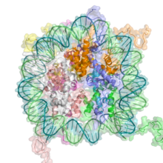
Other methods: epigenetics
Phenotype of cell is affected by which genes are transcribed, heritable transcriptions states can occur.
Changes are not associated with the underlying DNA sequence and such changes are referred to as epigenetic (epi - above).
Are biosynthetic gene clusters epigenetically switched off?

Slide 31
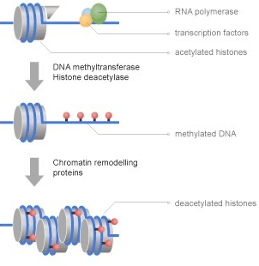
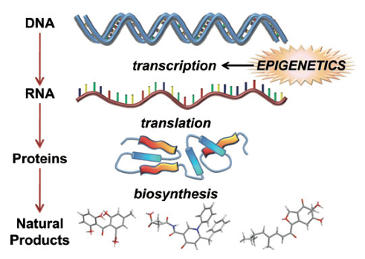
epigenetics
Principal mechanisms: post-translational modification of histone proteins that bind DNA (eukaryotes). Not completely unwound, not transcribed - can inherit modified histones.
Methylation of DNA(eukaryotes and prokaryotes), methylated DNA is less transcriptionally active - can be inherited.

Slide 32
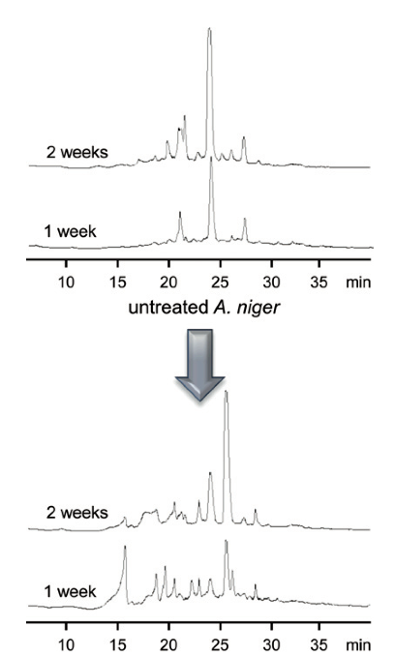
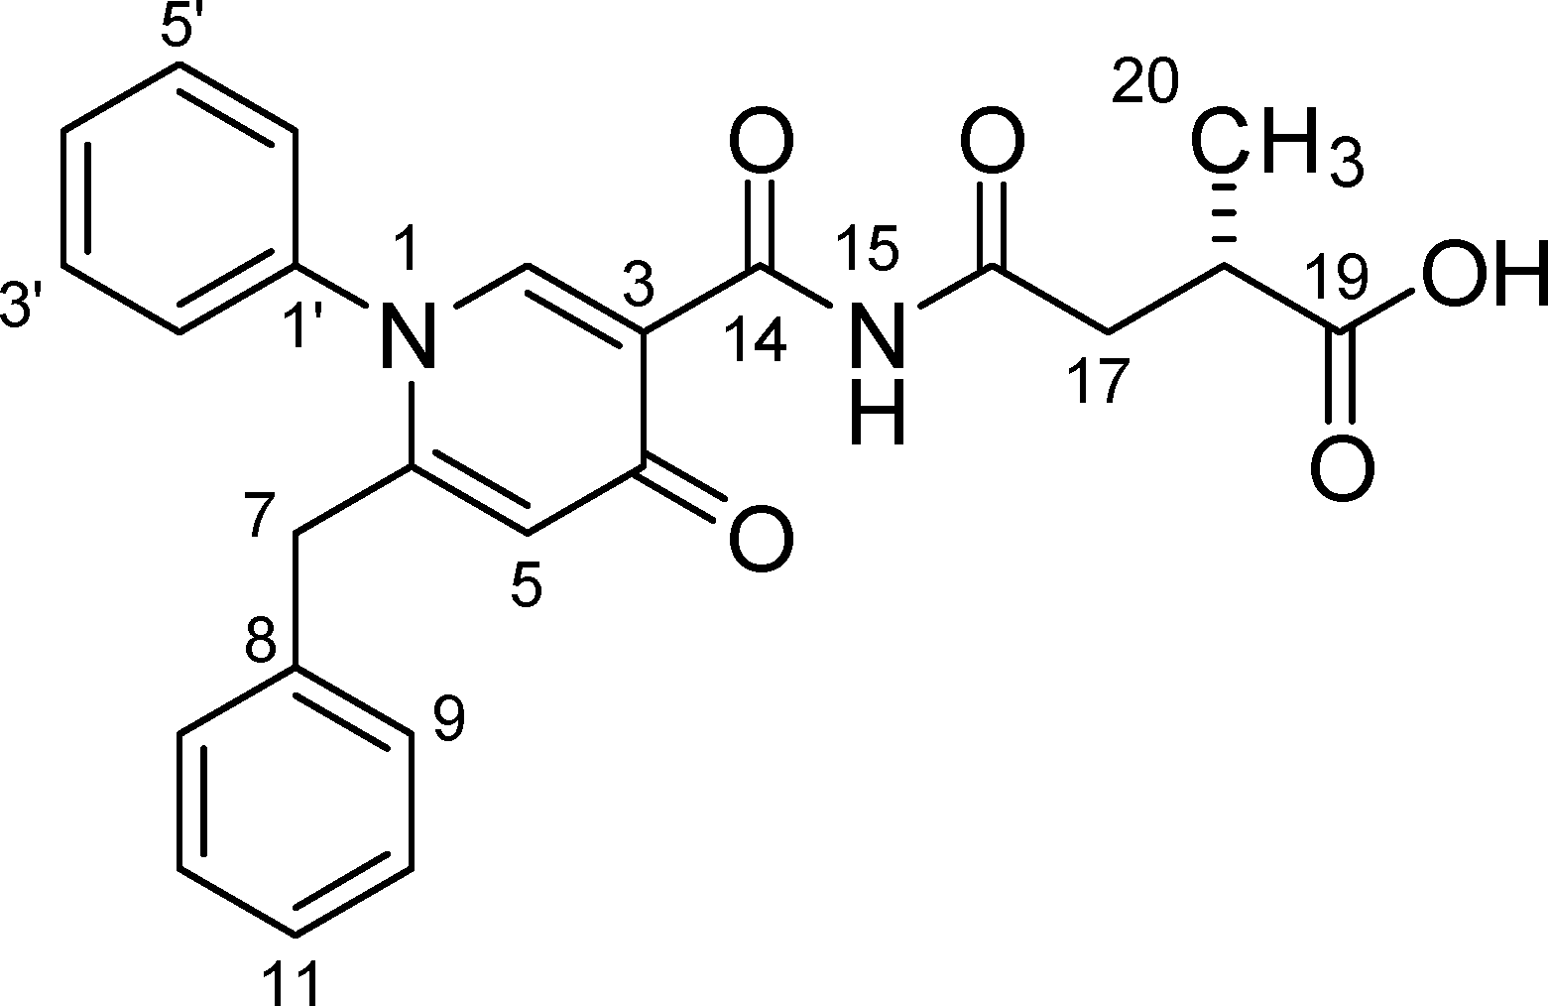
Epigenetic remodelling
Fungi were treated with DNA methyltransferase inhibitors.
A. niger has 55 biosynthetic gene clusters - 30% of which are transcribed under a variety of culture conditions.
Use of epigenetic modifiers resulted in transcription of the silent gene clusters.

Slide 33
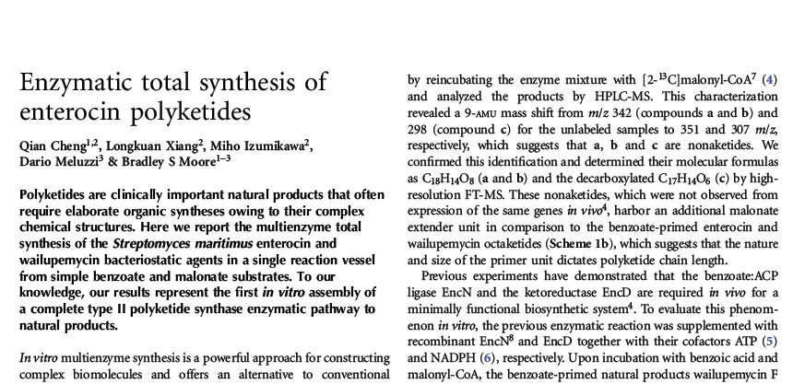
Do we need the microbes?
In the sense that the microbes are the source of the enzymes which perform the biotransformations that yield the natural product.
However, perhaps we can use the purified enzymes and place them in a single reactor vessel...

Slide 34
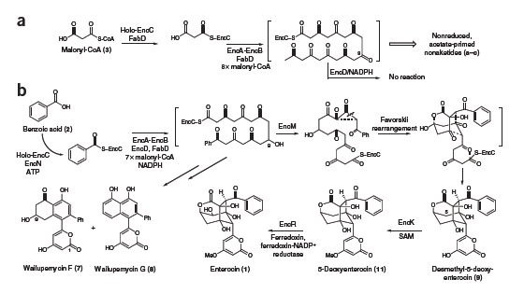
Authors purified all enzymes involved in the production of Enterocin. The purified enzymes were added, along with the precursors and co-factors, to a single reaction vessel. The result was a high-yield production of Enterocin - Think of the possibilities for synthetic natural products - any combination of enzymes, infinite products?

Slide 35
Summary part 3
The publication of the first genome of a Streptomyces sp highlighted that the majority of natural product biosynthetic gene clusters are silent or cryptic
The genomic information can be used to predict the structures of the cryptic gene clusters
Structural prediction is used to guide fermentation, isolation and purification
High-throughput genome scanning procedures can be used on large strain libraries to identify isolates harbouring novel biosynthetic gene clusters
Technology being developed for moving entire clusters into heterologous hosts (uncouple from regulatory network). Enables manipulation of the gene cluster in model organisms prior to expression in suitable host - combinatorial biosynthesis
Early stages of cell-free production of natural products using purified enzymes - an emerging biotechnology?

