Slide 1
Antimicrobials by design
BIO3030
BIO8041
Antimicrobial
Discovery
Jem Stach

Slide 2
Learning objectives
To understand the factors the contribute to a marketable antibiotic.
To become familiarised with medicinal chemistry.
To understand some of the approaches that have been used to design/improve antibiotics
i.e. we are focusing on human ingenuity in drug discovery.

Slide 3
Microbes have been making antibiotics for billions of years
Previous lectures have focused on the fact that microbes are the masters of making antibacterial compounds.
Driven by competition between microbes.
Evolution of antibacterial properties.
Human exploitation of these compounds for medicine.

Slide 4
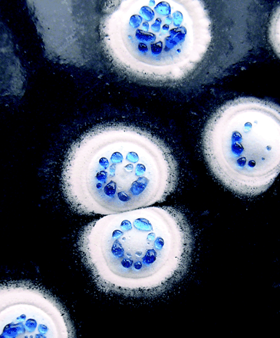
What properties does a good antibiotic have?
From microbe’s point of view:
Must restrict or prevent growth of competitor.
Must be amenable to a self-resistance mechanism.
Other secondary factors such as regulation of production.

Slide 5
What properties does a good antibiotic have?
From Pharma point of view:
Must be patentable; amenable to administration (preferably oral);
Distributed to infection site;
Mass produced (low cost)
Chemically modifiable;
Metabolised (elimination);
Non-toxic and have no toxic breakdown products.
Not the same concerns as the microbe - an antibacterial compound is not necessarily going to be antibiotic (in the drug sense).
Pharmacokinetics - compound absorption, distribution, metabolism, excretion and toxicity - ADME/T
Pharma make decision on hit and lead compounds based on ADME/T.

Slide 6
A hit is the beginning of a long journey
1940-70’s was the golden age of antibacterial discovery.
A the majority of antibiotic classes (unique chemical structure) used in the clinic today, were discovered during this time.
Antibiotics developed to both Gram-positive and -negative.
Natural product and synthetic antibiotics developed.

Slide 7
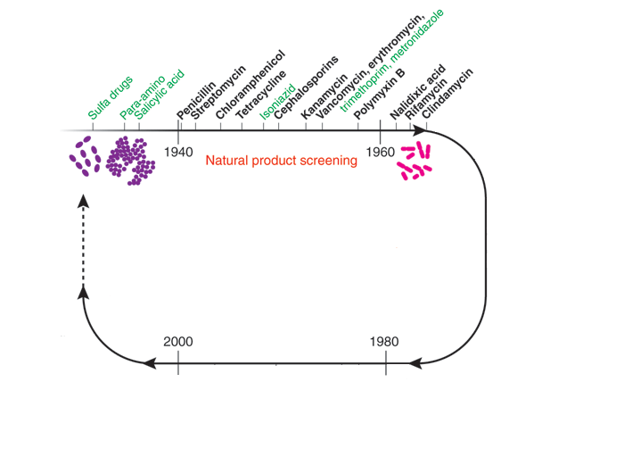
Green = synthetic product origin, Black = natural product origin. Gram +ve purple, -ve pink

Slide 8
Low-hanging fruit picked
1960-1970s resistance emerges
Rediscovery of known antibiotics (see previous lectures)
Same sources continued to yield leads in other therapeutic areas
Conclusion of Pharma: antibiotics from nature had been mostly found.
Solution: chemical modification of known antibiotics

Slide 9
Semi-synthetic antibiotics
The approach of improving on naturally occurring antibiotics carried less risk as the target, selectivity and toxicity of the starting antibiotic backbone was already defined.
Modification resulting in a new structure can be patented.
Very attractive route for Pharma - good reason to think that semi-synthetics will make the market

Slide 10
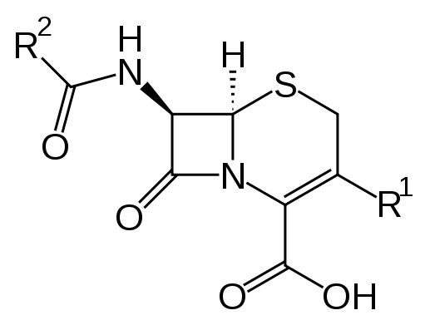
Cephalosporins
Cephalosporin isolated from fungi in 1948.
Disrupt synthesis of peptidoglycan layer of cell wall (β-lactam), less susceptible to β-lactamases.
Semi-synthetic cephalosporins made through chemical modification.
Core structure of Cephalosporin - R¹ and R² sites for modification

Slide 11
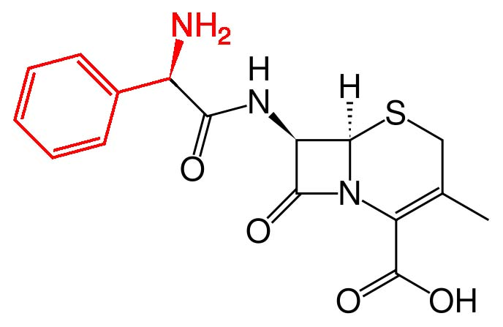
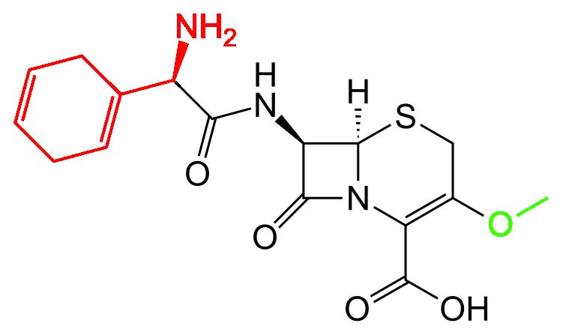
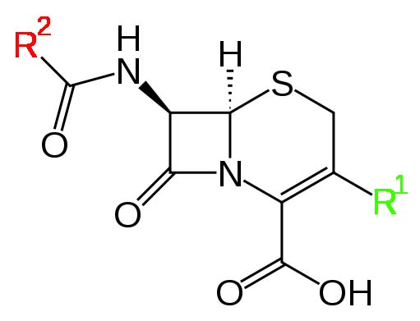
First generation
Chemical modification of core - first generation .
Broad-spectrum activity
No activity against Pseudomonas sp., Acinetobacter, Enterobacter

Slide 12
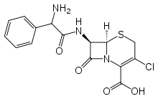
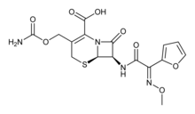
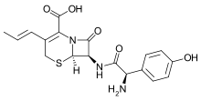
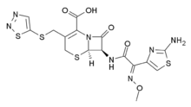
Second generation
The second-generation cephalosporins have a greater Gram-negative spectrum while retaining some activity against Gram-positive cocci. They are also more resistant to β-lactamase.

Slide 13
Third generation
Third generation increased activity against Gram-negatives. They can penetrate the CNS and treat meningitis

Slide 14
Fourth generation
Fourth generation: resistant to β-lactamses, can kill Pseudomonas sp.

Slide 15
Concepts from semi-synthetics: Medicinal chemistry
Medicinal chemistry: is defined as an interdisciplinary science situated at the interface of organic chemistry and life sciences (such as biochemistry, pharmacology, molecular biology, immunology, pharmacokinetics and toxicology) on one side and chemistry-based disciplines (such as physical chemistry, crystallography, spectroscopy and computer-based information technologies) on the other.
Herman L. Holt, Jr

Slide 16
Structure activity relationship (SAR)
Aspect of medicinal chemistry which relates to understanding how chemical modification of the structure of a compound relates to its activity.
Chemical synthesis used to introduce new functional groups (as in cephalosporins) then test how modification has affected biological activity
Aim is to be able to predict how changes will affect activity - design compounds to have specific properties.
Development of SAR - mathematical models used to predict SAR: quantitative SAR, or structure affinity relationship (SAFIR).

Slide 17
Medicinal Chemistry
Three critical steps:
Discovery: identification and production of lead compounds.
Optimization: synthetic modification of the lead to improve potency, lessen toxicity, increase selectivity, improve solubility...this step is exemplified by SAR studies.
Development: optimization for bulk production, modification of pharmokinetic properties for clinic (reduction of pain at injection site, elimination of unpleasant taste)

Slide 18
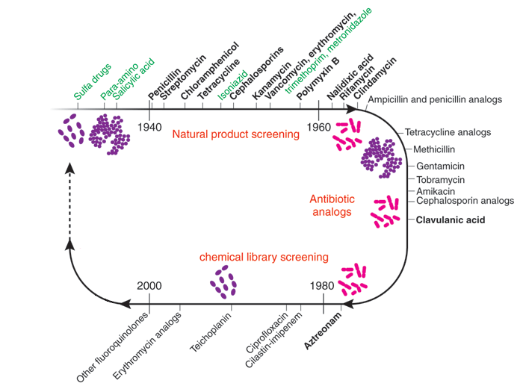
Green = synthetic product origin, Black = natural product origin. Gram +ve purple, -ve pink

Slide 19
Exhausted chemical space
Identification of semi-synthetic drugs (and market success) initiates “me-too” research in other Pharma companies e.g. development of ciprofloxacin from nalidixic acid - all most all Pharma companies start quinolone research programs.
After two decades no real improvements made to activity - semi-synthetics with market value are well covered.
Pharma returning to modification of old compounds that did not meet potency or spectrum requirements when originally isolated.

Slide 20
Summary part 1
Antibiotics mostly discovered decades ago.
Medicinal chemistry produced semi-synthetic compounds that increased time in clinic (overcoming resistance and changing activity).
Original targets have been well researched in terms of the chemical space available for making analogues with new activity.
Process: find a good target, find lead inhibitor, optimize the lead, create derivatives with novel activity.

Slide 21
Design of inhibitors
Previous lectures have demonstrated identification of essential targets.
This lecture will focus on the development and rational design of novel inhibitors for newly discovered targets.
Various approaches, but each focus on human ingenuity.

Slide 22
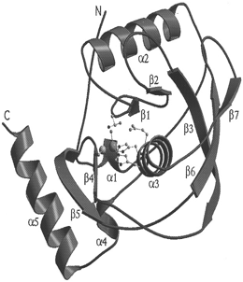
Deformylase inhibitors
Genomic studies in bacteria identified peptide deformylase as an essential gene (def)
Widely conserved and a metalloprotease - best studied enzymes, known SAR for inhibitors: Interesting target.

Slide 23
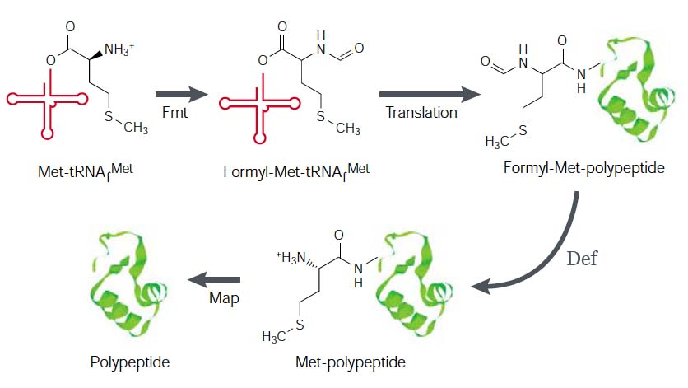
Protein synthesis in bacteria is initiated with N-formylmethionine - removed from nascent protein by Def - prokaryote specific mechanism - selective target

Slide 24
Def inhibitors
British Biotech screened a library of metalloenzyme inhibitors - using enzyme class to decide which chemical libraries to screen.
Identified a number of compounds that showed inhibition of Def, most have weak antibacterial activity.
As number of described inhibitors increases, predictions as to the core structural features of Def inhibitors can be determined.
Starting point for designing a library of potential inhibitors - hopefully with improved activity

Slide 25
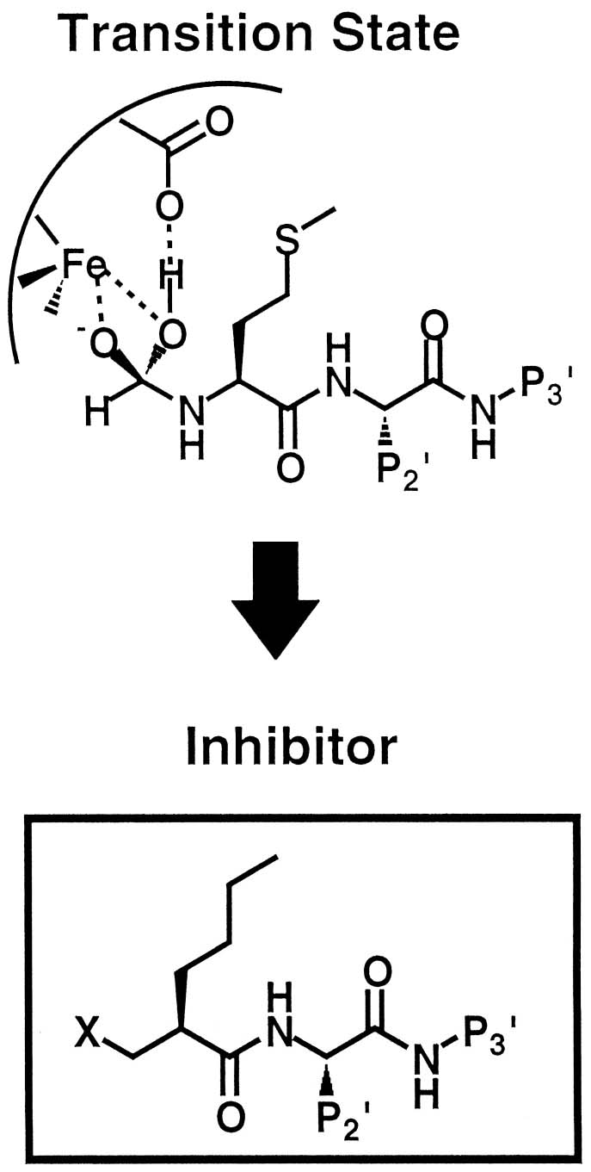
Core structure
Take a number of Def inhibitors and identify core similarity in structures.
Understanding of inhibitor interaction with Def enables prediction of core structure.
Design analogues around the core structure space.
Screen for activity (SAR).

Slide 26
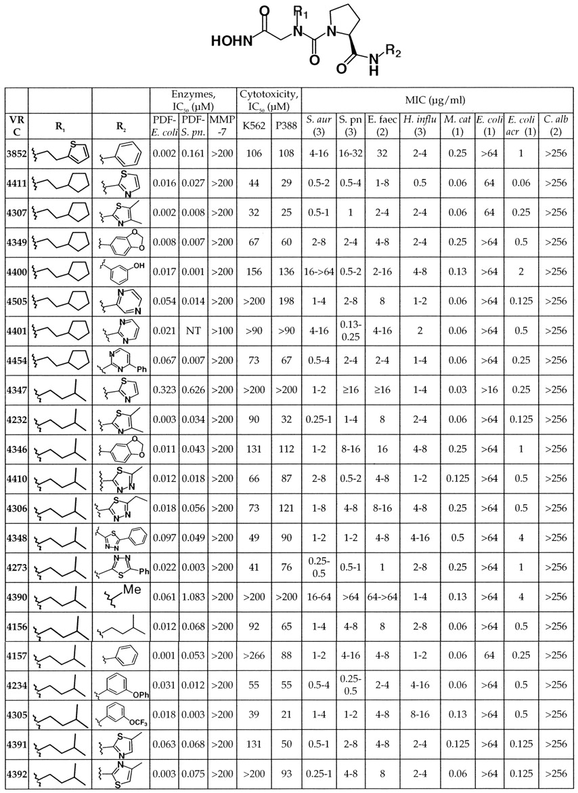


Slide 27
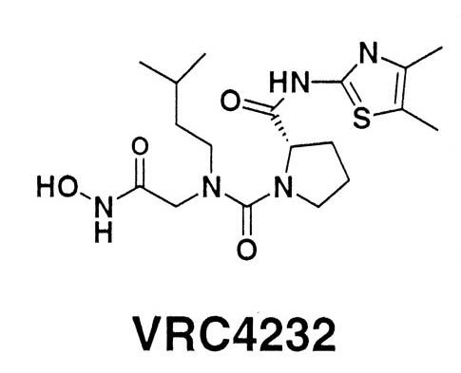
Def summary
Def identified as a target through genomics efforts
Confirmed as a metalloprotein
Library of metalloprotein inhibitors screened for antibacterial activity.
Resistance and expression studies confirm def as target
Medicinal chemistry to improve hits
Generation of lead compounds
First antibacterial derived from genomics efforts to enter clinical trials

Slide 28
Cell division
Bacterial cell-division proteins, in particular FtsZ are underexploited targets for antibacterial discovery.
Essential and widely conserved in bacteria.
FtsZ undergoes GTP-dependent polymerisation forming the Z ring at the mid-cell
Recruits other proteins and together they enable cell division to occur.
Structural relative of mammalian β-tubulin - well exploited anticancer target.
FtsZ should be amenable for inhibitor development

Slide 29
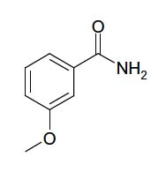
3-methoxybenzamide
FtsZ inhibition results in cell filamentation or ballooning, due to short-term growth in absence of cell-division.
3-MBA reported to cause cell filamentation, analysis of resistance mutants showed FtsZ is the likely target.
3-MBA is a weak antibacterial BUT it is a small and efficient ligand with on-target activity, that can penetrate the cell - good starting point fragment-based development to identify improved inhibitors of FtsZ.

Slide 30
Prolysis development of 3-MBA
Prolysis - spin out biotech based on research in Prof. Jeff Errington FRS laboratory.
Now director of Newcastle’s Centre for Bacterial Cell Biology (http://tinyurl.com/yl8fxt9)
Prolysis undertook a medicinal chemistry program based on 3-MBA.
Started by buying 3-MBA analogues from Sigma catalogue + in-house synthesis.

Slide 31
Screening
Use antibacterial assay (ensure analogues are still antibacterial) with cell-division inhibition check (ensure analogues are still on target).
Starting MIC of 3-MBA is 4000 μg ml⁻¹
Analysis of the analogues gives preliminary SAR for compounds

Slide 32
3-MBA SAR
Initial series of analogues showed that the amide and 3-ether substituents appeared to be critical for function.
Substitution of amide results in loss of on-target activity.
Substitution of 3-ether group gave one compound with improved antibacterial activity.

Slide 33
3-MBA SAR
SAR revealed that some substituents of the benzamide ring were tolerated.
Positions R⁴ and R⁷ could be substituted without loss of activity.
Small halogen substitution improved potency and retained on-target activity

Slide 34
combining the information
Explore substituents at 3-ether position = significant reduction in MIC with nonyloxy group.
Combine nonyloxy group with halogen substitutions in R⁴ and R⁷ positions.
Result is significant gain in potency and retention of on-target activity.

Slide 35
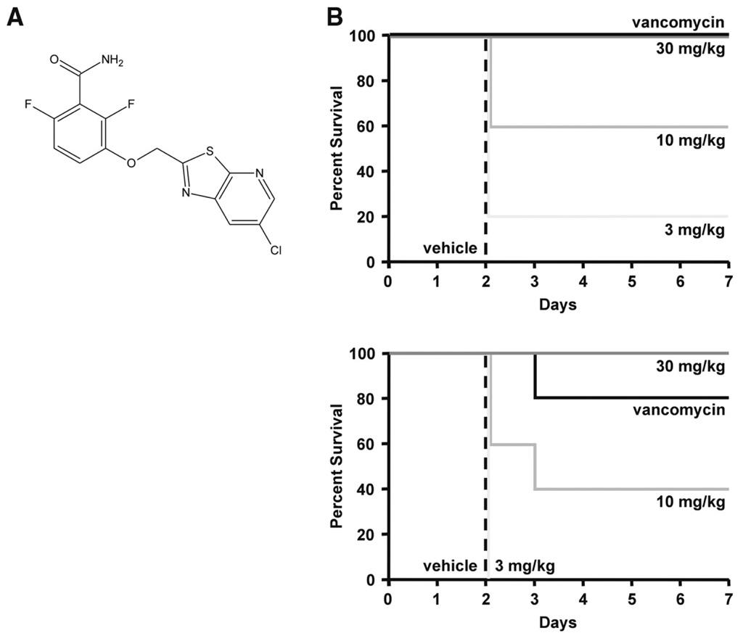
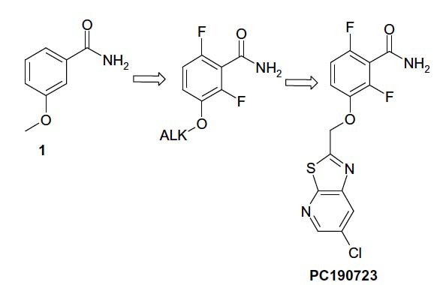
PC190723
Approach takes a small ligand with on-target activity.
Medicinal chemistry and SAR studies identify positions amenable to substitution.
Substitutions required to improve potency and retain on-target activity.
Result was PC190723: 10,000 X more potent than 3-MBA!

Slide 36
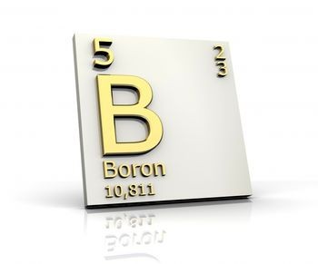
Boron
Synthetic chemists are not limited to the atoms that are commonly found in organic compounds with antimicrobial properties.
Boron has physical, chemical and biological properties that give chemists opportunities to synthesize compounds with novel activity.

Slide 37
Boron
For a long time this element has been overlooked by chemists - thought to be toxic (boric acid used as an insecticide)
Boric acid LD50 (oral does to rats) = 5.14 g/kg
Sodium chloride LD50 = 3.75 g/kg
Boron found in high concentrations in fruit, veg and nuts.
Not inherently toxic and can be used in medicinal chemistry
Boron can form bonds with target where a C, O, N or H atom may not.

Slide 38
Leucyl-tRNA synthetase - a promising antimicrobial target
Active site- adds leucine to tRNA^{Leu}
Editing site (ensures only leucine added)

Slide 39
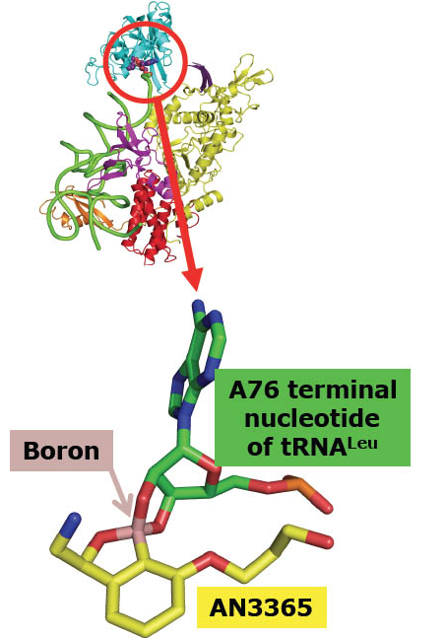
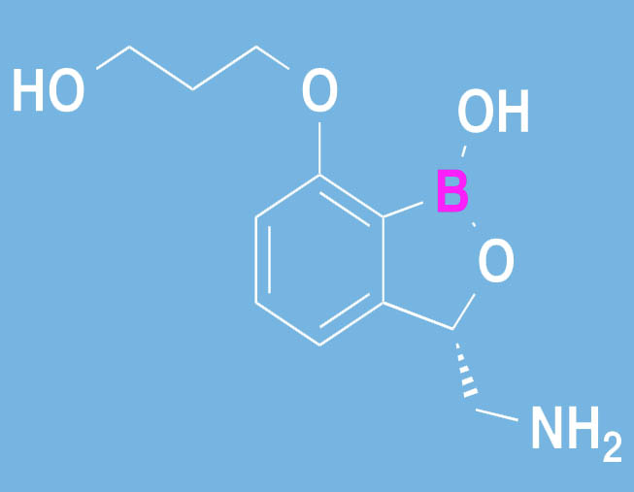
AN3365 - Boron containing inhibitor
AN3365 binds to editing site
Boron is absolutely essential to function

Slide 40
Summary part 2
Identification of novel target can be exploited if inhibitors can be found.
e.g. Def and FtsZ, inhibitors identified from libraries (chemical) and using medicinal chemistry and SAR studies, huge improvements can be made to the initial hit - lead development
Medicinal chemists are not limited to the use of atoms normally found in natural products - interesting properties can be incorporated using boron.

Slide 41
Drug development - a small but important digression
Pharma companies have learnt a huge amount about moving from a hit to a clinical drug (costs billions)
Like any company, it would be beneficial to reduce costs.
Large reduction in costs could be obtained by reducing the fall-out rate of lead compounds i.e. prediction of ADME/T early in the development process
Compounds that hit target, but will ultimately fail on ADME/T grounds can be rejected
Chemists have a large say in whether a hit will be amenable to medicinal chemistry that could alter ADME/T properties.

Slide 42
Lipinski’s rule of five
Rule of thumb to evaluate drug-likeness, or determine if a chemical compound with a certain pharmacological or biological activity has properties that would make it a likely orally active drug in humans.
Ideally, a new drug will be orally active - patient comfort, formulation, perception, cost...
These rules have had huge impact on what compounds are selected for further development - apply filters to libraries to remove those that are unlikely to result in orally active drugs

Slide 43
The famous 5*...an orally active drug should not break more than one of:
Not more than 5 hydrogen bond donors (nitrogen or oxygen atoms with one or more hydrogen atoms).
Not more than 10 hydrogen bond acceptors (nitrogen or oxygen atoms).
A molecular weight under 500 daltons.
An octanol-water partition coefficient log P of less than 5.
* four rules, multiples of 5, hence the rule of 5

Slide 44
Factor | Number
 | PC190723 | Lipinski Rules
H-bond donors | 2 | ≤ 5
H-bond acceptors | 5 | ≤ 10
Molecular weight | 355.75 | ≤ 500
log P | 1.44 | ≤ 5
Use of predictive rules to inform each stage of hit development - ensure that each compound conforms

Slide 45
Summary part 3
Possible to take hits with poor activity and, using chemistry, develop it into lead compound.
A lead compound is one which has the desired activity and whose structure is a starting point for modification.
Pharma companies apply filtering rules to decide which hits should be developed.
Lipinski’s rule-of-five has had the biggest impact on what compounds are developed.

Slide 46
Summary
Antibacterial compounds need to overcome many hurdles to make it to the market, including (but not limited to) activity, ADME/T and production costs
Can use genomics techniques in combination with chemistry to design highly improved antibacterials from poor initial hits - SAR studies and medicinal chemistry.
Predictions of what will make a drug are used by Pharma companies to prioritise lead development.
Such rules may not be appropriate for antibacterial compounds.

