Slide 1
Polypharmacology
BIO3030
BIO8041
Antimicrobial
Discovery
Jem Stach

Slide 2
Aims
To introduce the concept of polypharmacology
To explain the principal in terms of why natural product antimicrobials have been so successful
To introduce new research areas that can predict antimicrobial polypharmacology.

Slide 3
Identify target - attack
Examples from last lecture showed how a single target (Def, FtsZ) can be identified (as essential) and used to develop inhibitors.
Whole development ensured that all chemical modifications resulted in analogues that retain on-target activity.
We have discussed the problem that some single genes may be overlooked because they are only essential in the host
Is there anything else the process of identifying essential genes may overlook?

Slide 4
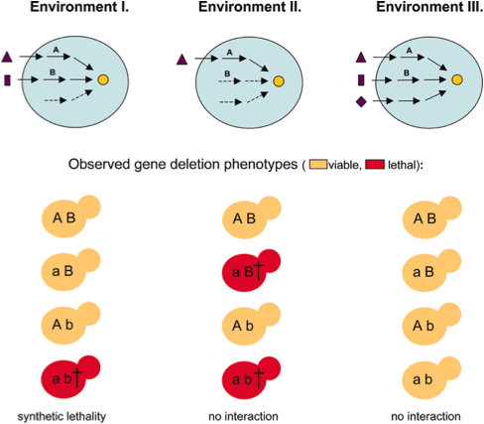
Synthetic lethality
Environments may exist in the human infection model where a single gene knockout is not lethal individually, but in combination with another gene is lethal
Concept: inhibition of two apparently non-essential proteins may be lethal
Implications for design of inhibitors
Metabolic genes A and B show synthetic lethality in Environment I, where starting nutrients of both pathways are present in the medium. However, B is unable to compensate deletion of A in Environment II, and the double mutant is rescued by the third pathway in Environment III.

Slide 5

discovery mantra
Conventional discovery (including examples in this lecture series) embraces the “one gene, one drug, one disease.
Focus on essential genes that are identified as singularly essential in lab conditions may miss interesting processes that could be targets of inhibitors.

Slide 6
Identify target - attack
However, identifying targets that are not essential in isolation, but are in combination is not trivial (multiple possibilities).
Are there any other potential drawbacks to the “one drug, one target” philosophy?
Briefly covered in Lecture 1.

Slide 7
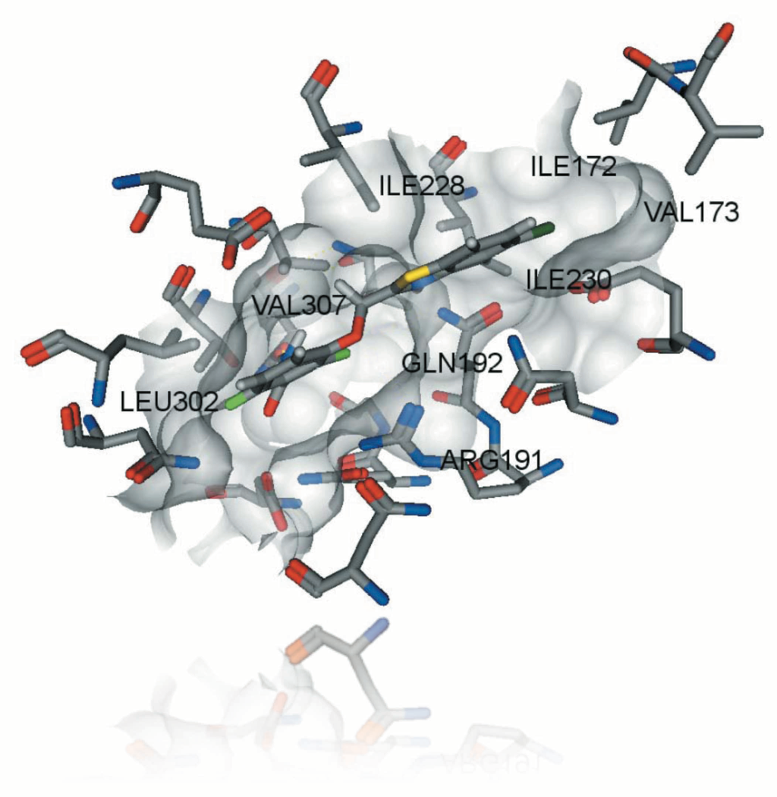
PC190723 - an example
Model of PC190723 bound to FtsZ - possible to where the enzyme and the inhibitor will form bonds with the amino acids of FtsZ
Point mutations in these amino acids could prevent binding

Slide 8
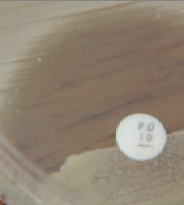
Single enzyme targets
A single target may only require a single point mutation in the enzyme to generate resistance
Spontaneous resistance mutants (SRRs)
SRRs always identified - it’s the rate that they are found which gives information as to its likely clinical efficacy (or shelf life).

Slide 9
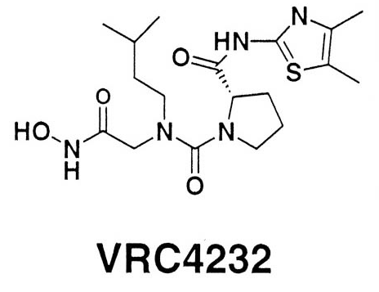
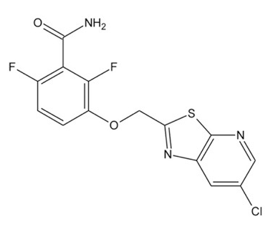
SRRs - synthetic antibiotics
VRC4232 (def inhibitor) 2 x 10⁻⁷ (S. aureus).
PC190723 (ftsZ inhibitor) = 2 x 10 ⁻⁸ (S. aureus)
One in every 20,000,000 bacteria will develop resistance to VRC4232.
10,000,000,000 bacteria in a single gram of your faeces.

Slide 10
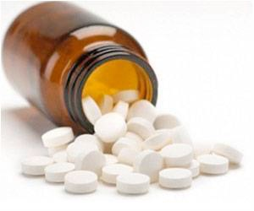
Why the difference?
Has significance in terms of how the compounds can be applied and their potential market value.
Antimicrobials can be used in mono- or combination-therapy
Compounds with high SRRs would need to be used in combination:

Slide 11

Multiple targets
Antibacterial drugs were often used in combination, success of antimicrobial compounds changed clinical perspective - monotherapy
Think of resistance in terms of two separate antimicrobials being used in combination...

Slide 12
Combination therapy
VRC4232 2 x 10⁻⁷
PC190723 2 x 10 ⁻⁸
If resistance to two antibiotics occurs by two different events, then the chance of the two mutations appearing in a single cell are the product of the two: 4 x 10⁻¹⁵
Less likely that sequential mutation would arise - point mutation in one enzyme does not generate resistance to combined treatment.

Slide 13

Other options
Two antimicrobials, two targets = lower chance of resistance.
Possible synergy - but antagonistic interactions are also possible
Other considerations: all of the ADME/T concerns but for two compounds. From a development point of view, two compounds have to go through clinical trails.
Compounds that have already gone through trials can be used together (later)

Slide 14
single drug - multiple targets
A single compound that inhibits two targets would be beneficial.
Benefit of lower SRR - same theory as for two inhibitors.
Could develop single compounds that had low resistance rates with the advantage of not being concerned with multiple ADME/T or possible antagonistic interactions.
Compounds being designed on this basis (see later) - will it work?

Slide 15
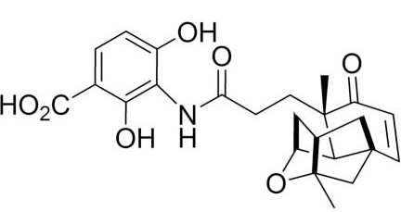
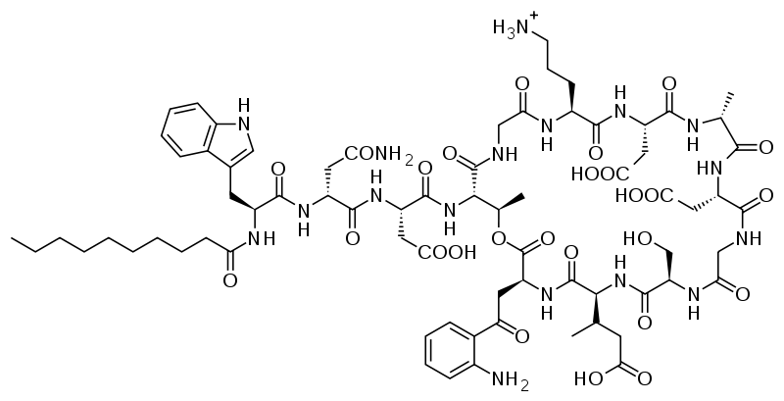
Very possibly:
Platencin = 1 x 10⁻⁹
Daptomycin = could not be found - serial passage and chemical mutation identified resistance mutants, but these mostly had increased susceptibility to other antibiotics or attenuated virulence (multiple species)
Natural products often have multiple targets

Slide 16
Examples
β-lactams address the whole target family of penicillin-binding proteins (PBPs).
All bacterial species have more than one PBP
No β-lactams inhibits all PBPs, but most target more than one essential PBP.
Glycopeptides target a substrate that is assembled and processed by multiple enzymes.

Slide 17
Compound class | Examples | Target-related spontaneous resistance | Target encoded by single gene | Therapeutic application
Peptidoglycan biosynthesis
β-Lactams | Penicillin ceftriaxone imipenem | Slow | No | Monotherapy
Glycopeptides | Vancomycin | Very slow | Not gene encoded | Monotherapy
d-Cycloserine |  | Rapid | No | combination only
Fosfomycin |  | Slow | No | combination only
Protein biosynthesis
Macrolides | Erythromycin; azithromycin | Slow | No | Monotherapy
Lincosamides | Clindamycin | Slow | No | Monotherapy
Oxazolidinones | Linezolid | Slow | No | Monotherapy
Tetracyclines | Tetracycline; doxycycline | Slow | No | Monotherapy
Aminoglycosides | Gentamicin; tobramycin | Slow | No | Combination partner in severe infections
Fusidic acid |  | Rapid | Yes | In combination
DNA replication
Fluoroquinolones | Ciprofloxacin; levofloxacin | Medium | No | Monotherapy
Coumermycin antibiotics | Novobiocin | Rapid | Yes | In combination
Transcription
Ansamycines | Rifampin | Rapid | Yes | In combination
Folic acid metabolism
Sulfonamides | Sulfamethoxazole | Rapid | Yes | Mostly in combination
Benzyl-diaminopyrimidines | Trimethoprim | Rapid | Yes | Mostly in combination
Daptomycin |  | Slow | No | Monotherapy

Slide 18
Polypharmacology
Term describes the phenomenon that a drug acts on multiple targets rather than a single target.
Most natural product antimicrobials are have polypharmacological properties
N.B. remember they were discovered decades ago - whole cell screening. Only interested in activity, not the target.
Likely that most of the targets of current antimicrobials would have been dismissed in the “one gene, one target” strategy

Slide 19
Harnessing polypharmacology
emerging field is that of dual-action hybrid (heterodimer) antibiotics.
Strategy: two molecules that inhibit separate compounds are covalently linked into one molecule.
One molecule: single pharmacokinetics.
possible to use the penetration capacity of one antibiotic to improve the activity of the second.
improve the inhibition on both targets.
possible to reduce toxicity of one, by attachment to the other.

Slide 20
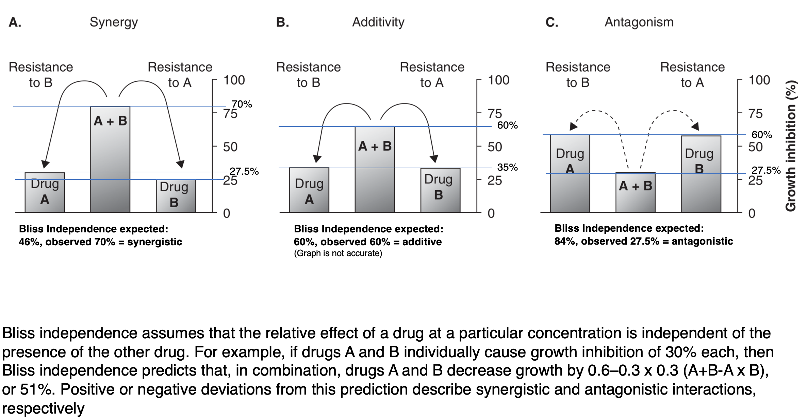
Drug interactions

Slide 21
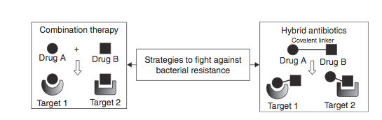
hybrid antibiotics
Main goal is to develop hybrid antibiotics that have synergistic (greater than the sum of the parts) activity and reduced resistance

Slide 22
Fluoroquinolones
Fluoroquinolones already inhibit two targets (DNA replication)- any disruption to binding by covalent attachment of second compound would likely be compensated for.
Highly efficacious, but resistance arises quickly (SRRs in target enzymes reported). Reduced activity against Gram-negatives
linkage of fluorquinolones to oxazolindinones (protein synthesis inhibition) predicted to improve efficacy

Slide 23
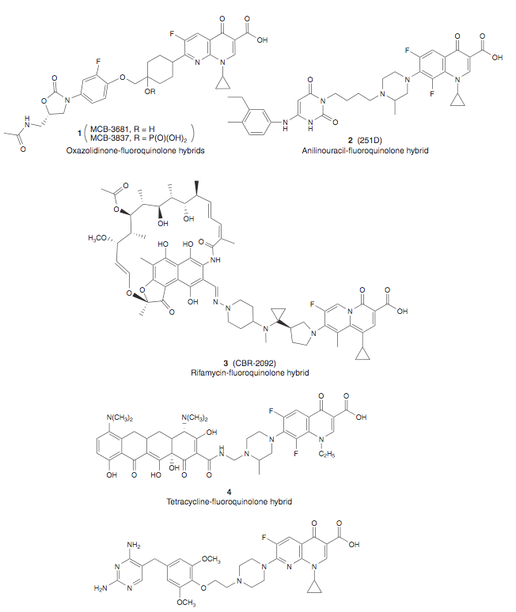
Series of hybrids made - several show synergistic activity and balanced inhibition of both targets.
Improved activity against drug-resistant bacteria, Both Gram + and - (not Pseudomonas)
Many other examples with different compound classes

Slide 24
Clinical trails
All hybrid molecules currently investigated have been reported to have impressive resistance-breaking properties.
Most advanced are showing advantages over plain combination therapy - hybrids retain activity in double mutants resistant to both parent compounds.
Not showing huge benefits in most Gram-negative pathogens - Why?

Slide 25
Possibilities of polypharmacology
The study of drug-target networks may aid in the understanding of polypharmacolgy - improve rational design
Computational methods can be used to predict drug-target networks
Aim to increase the number of targets that can be exploited by examining all targets simultaneously
N.B. in M. tuberculosis, 9 of the 4,000 proteins have been investigated as targets.

Slide 26
The Drugome
Computational approach links the structural proteome of an organism to all structurally characterized drugs
Example with M. tuberculosis
Creates a proteome-wide and multi-scale view of target drug space
Aim is to aid in the development of new antimicrobial compounds

Slide 27
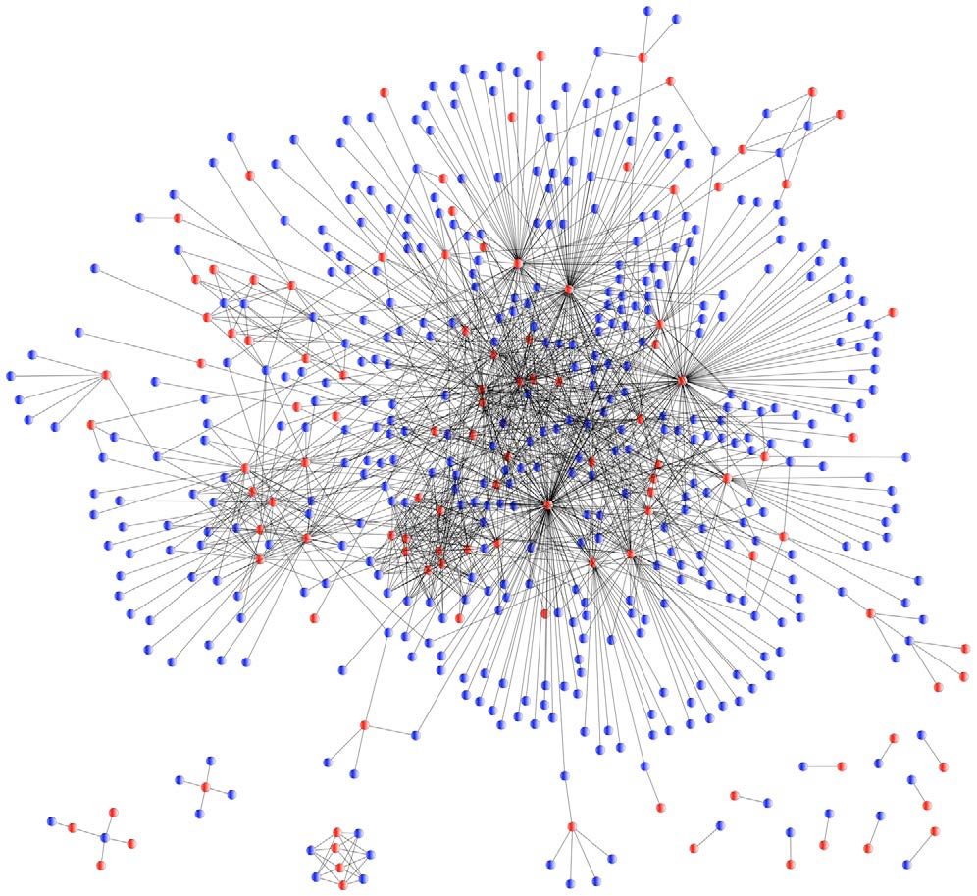
A protein-drug interaction network to illustrate similarities between the binding sites of M.tubersulosis proteins (blue), and binding
sites containing approved drugs (red). Highly connected - drug binding site similarities in structurally distinct proteins

Slide 28
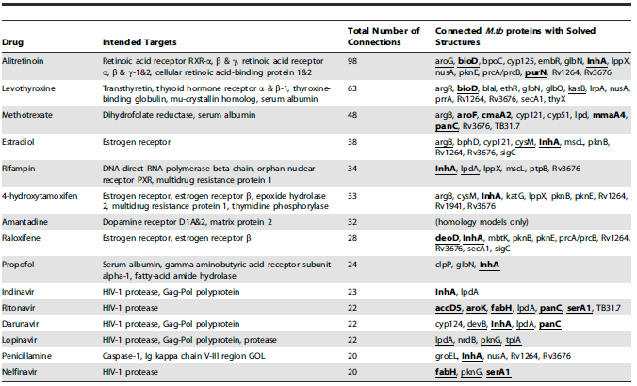

Slide 29
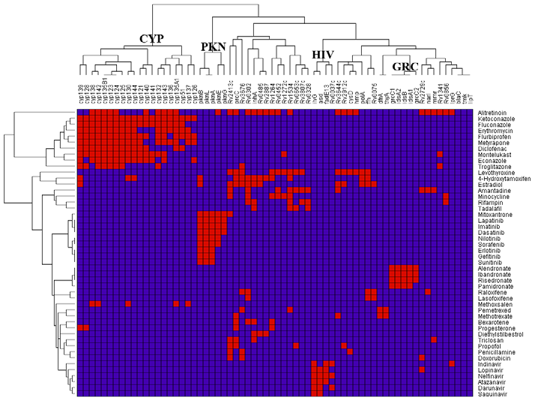
Identifying clusters
If all members of a set of related proteins can bind the same set of multiple drugs then that cluster could represent an excellent target for discovery.
Clustering reveals such targets

Slide 30
HIV drugs identified as potential inhibitors of TB - current co-administration of TB and HIV drugs is undesirable - potential to identify new single molecule treatments for both

Slide 31
large benefits
By bridging target and drug space, interaction networks can give information about the use of existing drugs as lead compounds in development
Drugs could predictable be repositioned directly to the target - saves huge costs
One third of the drugs examined could be repositioned as anti-TB drugs
Implications for taking drugs that are cheap to produce and clinically evaluated and reformulating for diseases with lower value markets.

