Slide 1
Antimicrobial Drug Discovery
BIO8041

Slide 2
Module overview
Intended Knowledge Outcomes
The aim of this module is to demonstrate various routes to the discovery of microbial products with commercial value. The module aims are to familiarise students with a number of different approaches that have been undertaken in the search and discovery of antimicrobial compounds. The module also aims to give students the practical skills to search for antimicrobial compounds.
Intended Knowledge Outcomes
By the end of the course, students will have acquired an understanding of the use of microbes in the production of high value compounds. The course focuses on bacterial systems, and the application of these organisms in the search and discovery process. The students will be exposed to primary research papers, that will serve as the basis of each lectures. Thus, students will gain knowledge of a number of different experimental routes to the identification and production of valuable microbial compounds.

Slide 3
Lectures
Dates of lectures available online (timetabling).
May be subject to change.
1. Introduction
2. Phage-based antimicrobial discovery
3-4. Antisense methods
5. Genomics & metagenomics
6. Antifungal discovery
7. Array-based approaches
8. Inhibitor - target modelling
9. Misc. approaches to antimicrobial development
10. Synthetic biology

Slide 4
Methods of Assessment
60% Practical report - In depth report based on practical data and problem solving
40% In class tutorial sessions x 2 (20% each) - (2nd March, 23rd March). Students have the chance to explore any aspect of the course in a revision setting, followed by
an MCQ test.

Slide 5
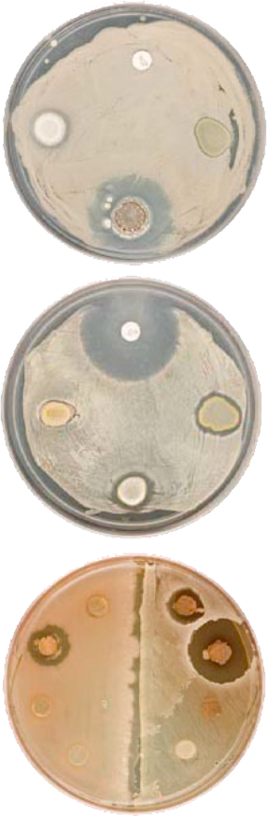
Practical
Designed to give you an appreciation of the methods used in the search for antibacterials.
In the practical you will isolate Streptomyces species and screen them for antibacterial activity
The lab class is designed as a group activity i.e. please share and discuss results.
Practical will also introduce novel screening concepts

Slide 6
Antimicrobial Drug Discovery
Antibacterials overview
Jem Stach

Slide 7
What you
need to
know
The current state of research regarding antimicrobial natural products discovery
The reasons for optimism regarding discovery
Some of the methods that are being used to improve the discovery of novel antimicrobial natural products
Examples of products that have been discovered using these techniques

Slide 8
Why the decline?
Worrying decrease in approvals

Slide 9

20/07
15/08
02/09
20/09
01/10
06/10
13/10
17/10
JH1
JH2
JH5
JH6
JH9
rifampin
imipenem
vancomycin
1. Point mutations appeared in genome of JH1 - mutations retained once acquired (35 in total)
2. Following rifampin therapy the resistance of isolate JH1 increased to this antibiotic increase > x 1000 fold
3. Vancomycin susceptibility gradually declined (JH9 eightfold more resistant than JH1)
4. JH6 - JH9 resistant to daptomycin - never treated with this compound.
A terrifying example of the nature of antimicrobial resistance

Slide 10
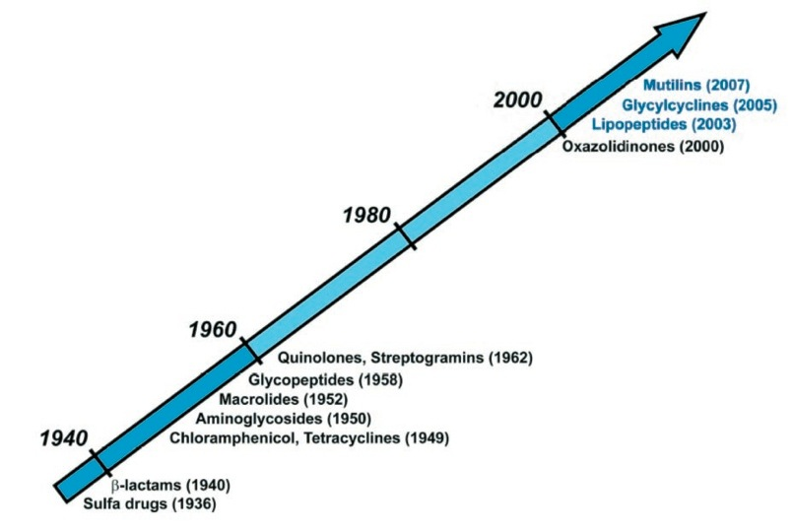
Why the decline in discovery?
A period of high rediscovery - economically unappealing to big pharma – the low hanging fruit has all been picked
Approval of new antimicrobials takes years, small period of patent protection once released
A good antibiotic is used for a short period of time - not the case with lifestyle drugs - more profit
Resistance develops quickly - a large investment from a company in a drug that may be ineffective very quickly.
Combinatorial chemists developed systems for making millions of new compounds per week, thought that natural products were unnecessary.

Slide 11
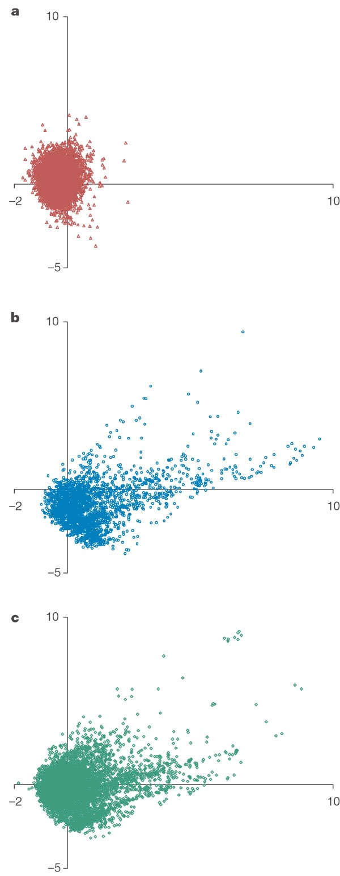
Natural Products are structurally more diverse than compounds made by combinatorial chemistry
This figure shows the product space (2D ordination space) covered by combinatorial chemistry (cc), natural products and marketed drugs
All natural products have been selected by evolution to interact with biological systems – broadly speaking, they bind to biological macromolecules
Chemical diversity of drugs and natural products is similar and in general they have greater chirality and aromaticity than cc products that are in general planar

Slide 12
So what now?
If combinatorial chemistry does not deliver new antibacterials and novel natural products are not being discovered, where will new antibiotics come from?
Currently both combinatorial chemists and natural product scientists are improving their respective sciences to produce new antibacterial compounds
Combinatorial chemists are synthesizing more drug-like compounds (smaller, higher quality libraries) and using target-orientated design.
Natural products: a number of recent developments have lead to a resurgence in natural product discovery.

Slide 13
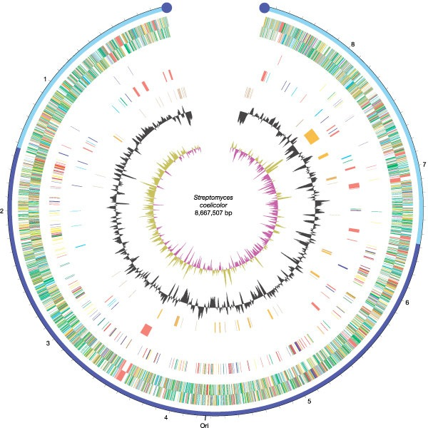
Genome sequencing
Actinomycetes, and in particular the genus Streptomyces are the most prolific antimicrobial producers.
First genome sequence of a Streptomyces species revealed something fascinating and unexpected:
There were approximately 20 separate biosynthetic gene clusters for natural products!
Only three natural products had been isolated from this organism – 85% of natural products that this species can synthesize are as yet silent or cryptic
Genome sequencing of other actinomycetes has revealed the same pattern – the vast majority of natural products remain undiscovered
Some have estimated that there may be 100,000 new natural products awaiting discovery in the genus Streptomyces alone!

Slide 14
Combining chemistry and genomics
If microbial species have the potential to make 20 or more different natural products, why have they not been discovered? – Screening of strains has been conducted for ca. 60 years

Slide 15
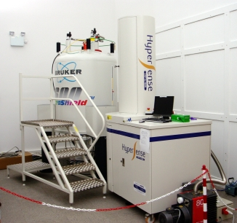
Analytical improvements
The improvements in natural product discovery can be broadly divided into two main areas: biotechnology and analytical chemistry.
This lecture will focus on biotechnology, however it is important to note that improvements in the sensitivity of analysis of crude natural product extracts has increased greatly.
The historical high rediscovery rate was largely due to the fact that it took months (years) and grams of material to identify chemical structures present in active extracts. Most of the instrumentation used was not able to handle samples that contained multiple chemical entities
The various available hyphenated techniques, e.g., GC-MS, LC-PDA, LC-MS, LC-FTIR, LC-NMR, LC-NMR-MS, CE-MS, have made possible the pre-isolation analyses of crude extracts or fractions from different natural sources, isolation and on-line detection of natural products, chemotaxonomic studies, chemical finger printing, dereplication of natural products, and metabolomic studies

Slide 16
Methods of discovery
In order to improve discovery of novel antibiotics researchers have focused on a number of areas:
Identifying new targets for inhibition
Improving detection - chemical analysis (as above) and indicator strain construction
Development of novel screens (combinations of above)
Isolate novel organisms
Apply genomics to the expression of cryptic biosynthetic genes

Slide 17
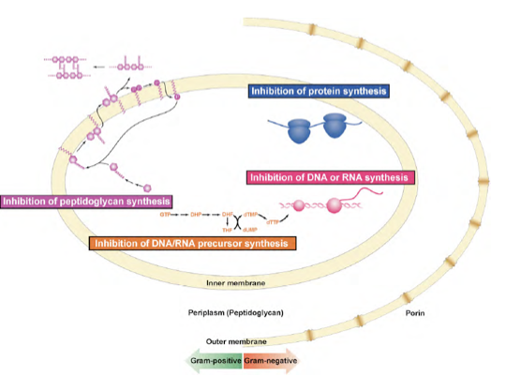
Identifying new targets
Traditional targets - those with marketed antimicrobials

Slide 18
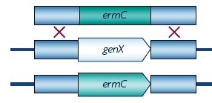
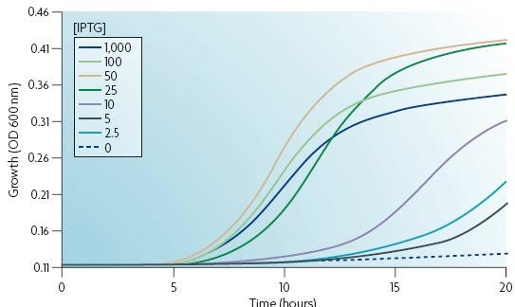
Identifying essential genes
Why would we wish to identify essential genes? Suggestions...
Genes identified as essential produce essential proteins - inhibition of essential proteins should lead to cell death - novel essential genes therefore lead to novel targets for screening
How do we identify essential genes? Suggestions...
  Why is there a risk of missing something important with this strategy? Suggestions...

Slide 19
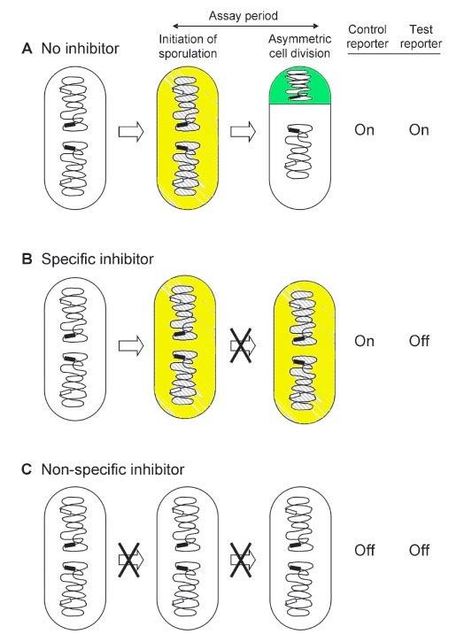
Novel strains for screening
Once novel essential genes are identified, mutant strains are constructed that can act as reporters of inhibition.
Example: B. subtilis strain for reporting ftsZ inhibition (Novel Inhibitors of Bacterial Cytokinesis Identified by a Cell-based Antibiotic Screening Assay) on Blackboard
Also construction of antisense reporter strains with improved sensitivity to inhibition (lectures to come)

Slide 20
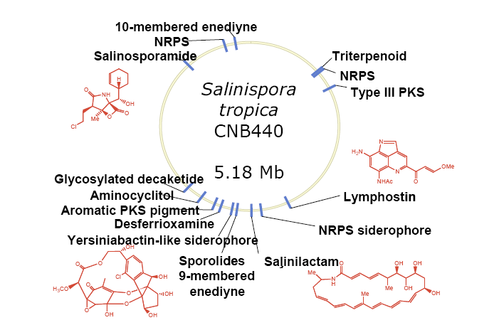
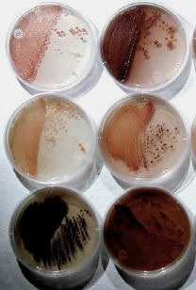
novel organisms
Why would novel species be of interest? Suggestions...
Theory: Some speculate that the evolution of novel bioactive secondary metabolites, is a driver of speciation
Thus novel species equal novel compounds
Great deal of interest in Marine actinomycetes

Slide 21
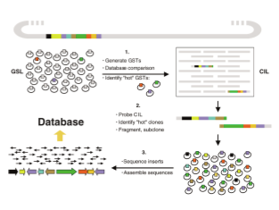
Genomic approaches
Gene clusters responsible for natural product biosynthesis are typically 20-100 Kb in size
Genome size of a typical Streptomyces sp. is 8.5Mb
Thus, if we make a genomic DNA library from the strain and clone and sequence 1000 segments (700 bp) of the genome we will sample the genome every 8.5 Kb and sample any gene cluster between 2 and 20 times.
These small segments are use to generate probes. The probes are used to identify clones carrying large (ca. 40 Kb) segments of genomic DNA.
Thus, the whole biosynthetic gene cluster is sequenced
Bioinformatics is applied to predict the structure of the natural product.

Slide 22
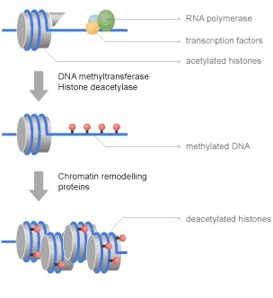
Epigenetics
Much interest in using chemicals to prevent epigenetic modification and force transcription of cryptic biosynthetic gene clusters.
Possible route to novel antibacterials

Slide 23
Summary
The problem of microbial resistance to antibiotics is a serious threat to the health and wealth of the world
New methods are needed to identify novel antibiotics
A number of techniques are being reported that can be used singularly or in conjunction that have been successful in discovery
Specific techniques will be covered in lectures

