Slide 1
Blogging in Urban Design Education: A Virtual Public Domain of Exchange
www.nclurbandesign.org
Georgia.Giannopoulou@ncl.ac.uk Ashley.Wright@ncl.ac.uk

Slide 2
What we did
A Blog as a virtual “live” student designed handbook
Incorporated in existing modules and marked
Minimum contribution requirements
Instigated and facilitated by us but not led…
Control gradually to students
Moved from WordPress.com (2010/11) to WP.org (hosted) in 2011/12
Started in 2011, repeated in 2012, 2013…..
Gained publicity : Presented at Durham Annual BB Conference, 3Rivers Teaching and Learning Conference, and Internal Teaching and Learning Conference with positive response, Business School….

Slide 3
Why we did it originally
To capture the experience of a 1-year cohort
(MA in Urban Design)
Mentoring through alumni
To promote reflection in learning
To foster community
To promote the course
To promote personal attributes e.g autonomy, reflexivity, cultural competence, inclusivity in higher education students

Slide 4
How we did it : The brief

Slide 5
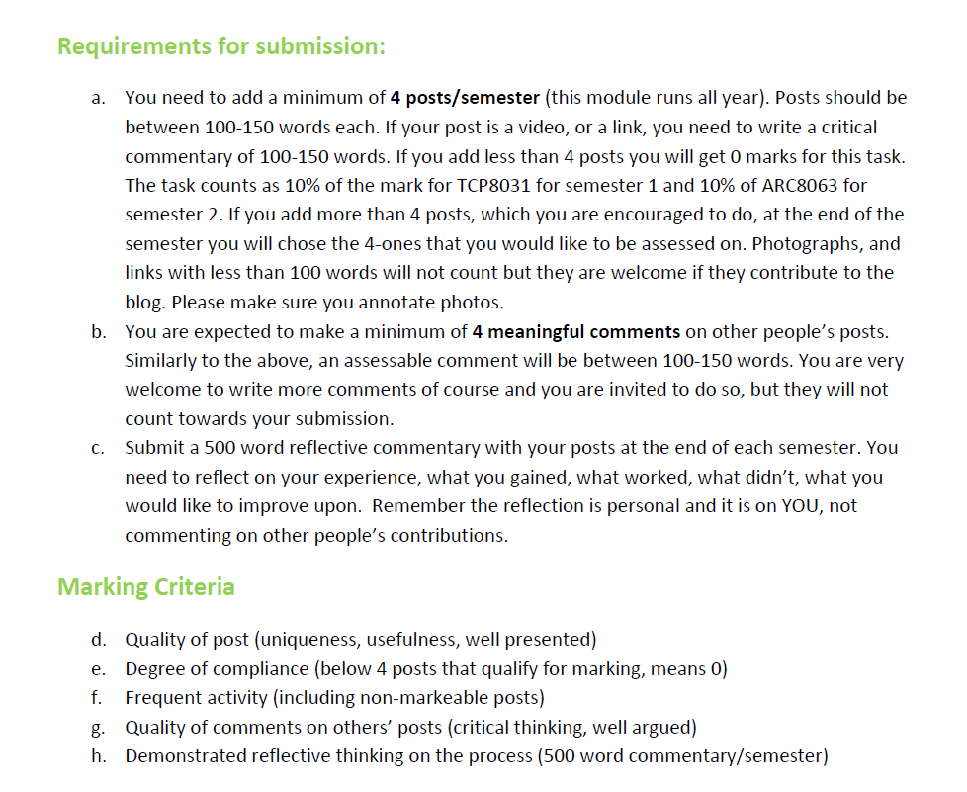
How we did it : The brief
Notes:
Note here that the frequency is already one of the criteria

Slide 6
What are the challenges
Scalability
Institutional policy – catch up
WordPress – risks of the unknown, open source forever?
Motivation for posting in amongst course requirements
Representation of Newcastle University from such an open platform…
Democratic procedures and management
Aesthetics: students want freedom to personalise
Marketing and students
Does the brief fit the cohort?

Slide 7
What did the students gain : quotes 2010
“…Helpful to know where we all stand different”
“…Helped me organise my thoughts and ideas and get feedback”
“…A window to places I have never been and never really thought of”
“…I have been genuinely surprised by how much I have enjoyed blogging/commenting and how interesting and useful I found other people’s comments”
“…Open up lines of communication”
“…A supportive message for next year’s students, with current students imprint”

Slide 8
What did the students gain : quotes 2011
“…the Blog has helped me see how each of us bring our own cultures, experiences and personality to the table. This further stresses to me the importance of a multidisciplinary approach to the field””(Jeremy, U.S)
“…outside it where I find myself, this blog is where I maintain the self-consciousness and further my steps as a designer” (Jing, China)
“…I was really proud with the constructive criticism I got from my colleagues and friends” (Aly, Egypt)
“…what I found invaluable is the way in which our individual learning is enriched so greatly by the world wide spread of individuals experience and interests all joined together in one place” (Jesse, U.K)
“…I am a part of a whole greater body who has the authority and the power to shape my own image, to chose by myself how I should appear to the world…” (M.D, Vietnam)

Slide 9
Lessons
Every cohort is different and that’s the beauty of it!
More sophisticated technology and connections needs more support
Constant tweaking of the support needed to suit
Added to my workload but we all rip benefits
A clear and open brief is the key to the success
The Blog brings together all the learning from modules
Need a system to ensure frequent posts
There are some costs associated…

Slide 10
Blogging in Urban Design Education: A Virtual Public Domain of Exchange
www.nclurbandesign.org
Georgia Giannopoulou and Ashley Wright

